Slide 1

1 June 2025
“Long Range Planning Post Survey Results”
142 Post Surveys

Slide 2
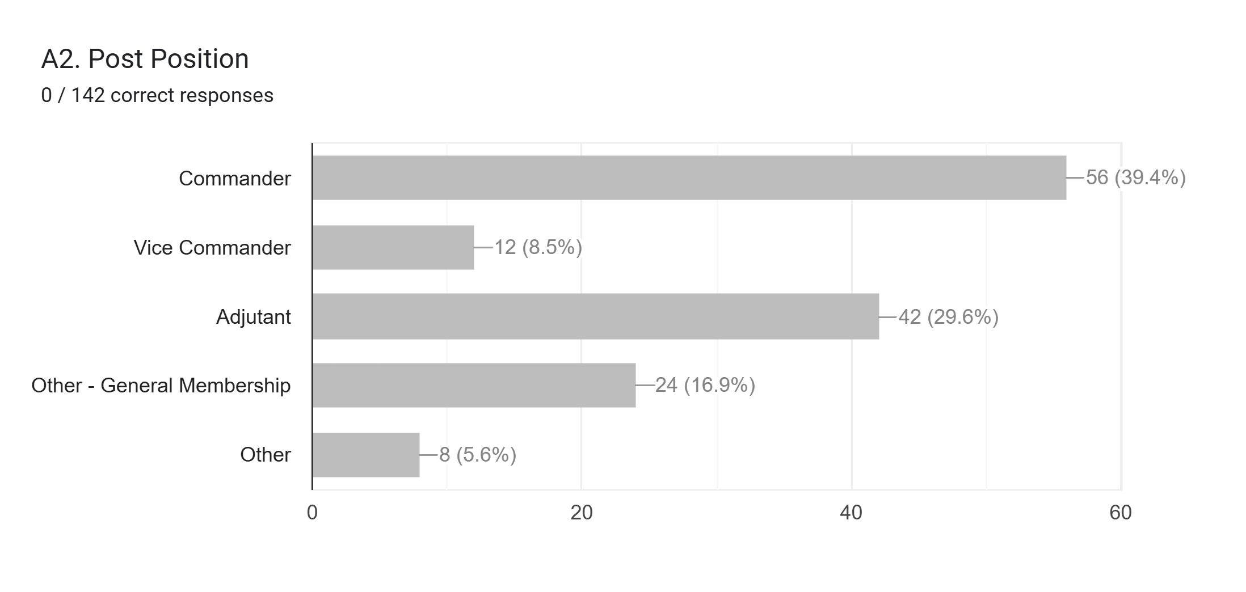

The American Legion, Department of Texas, Long Range Planning
* - Leadership represented 77.5%, need more involvement and feedback from general membership.

Slide 3
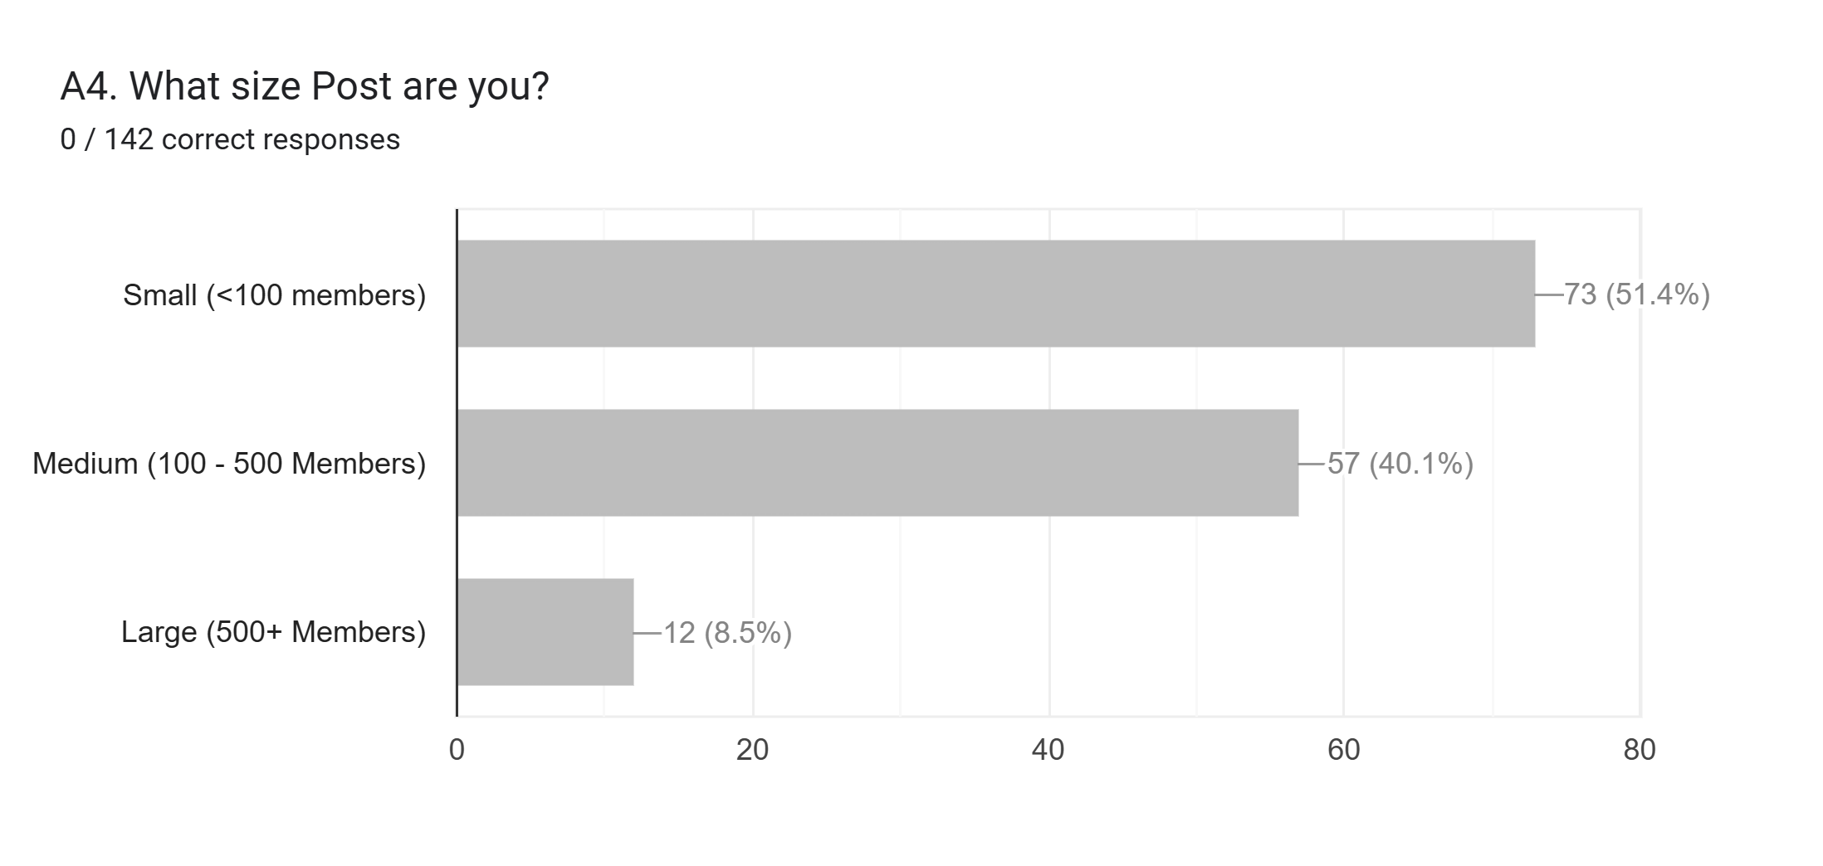
The American Legion, Department of Texas, Long Range Planning
* - Keep in mind that the majority of the surveys were from Small and Medium Posts.

Slide 4
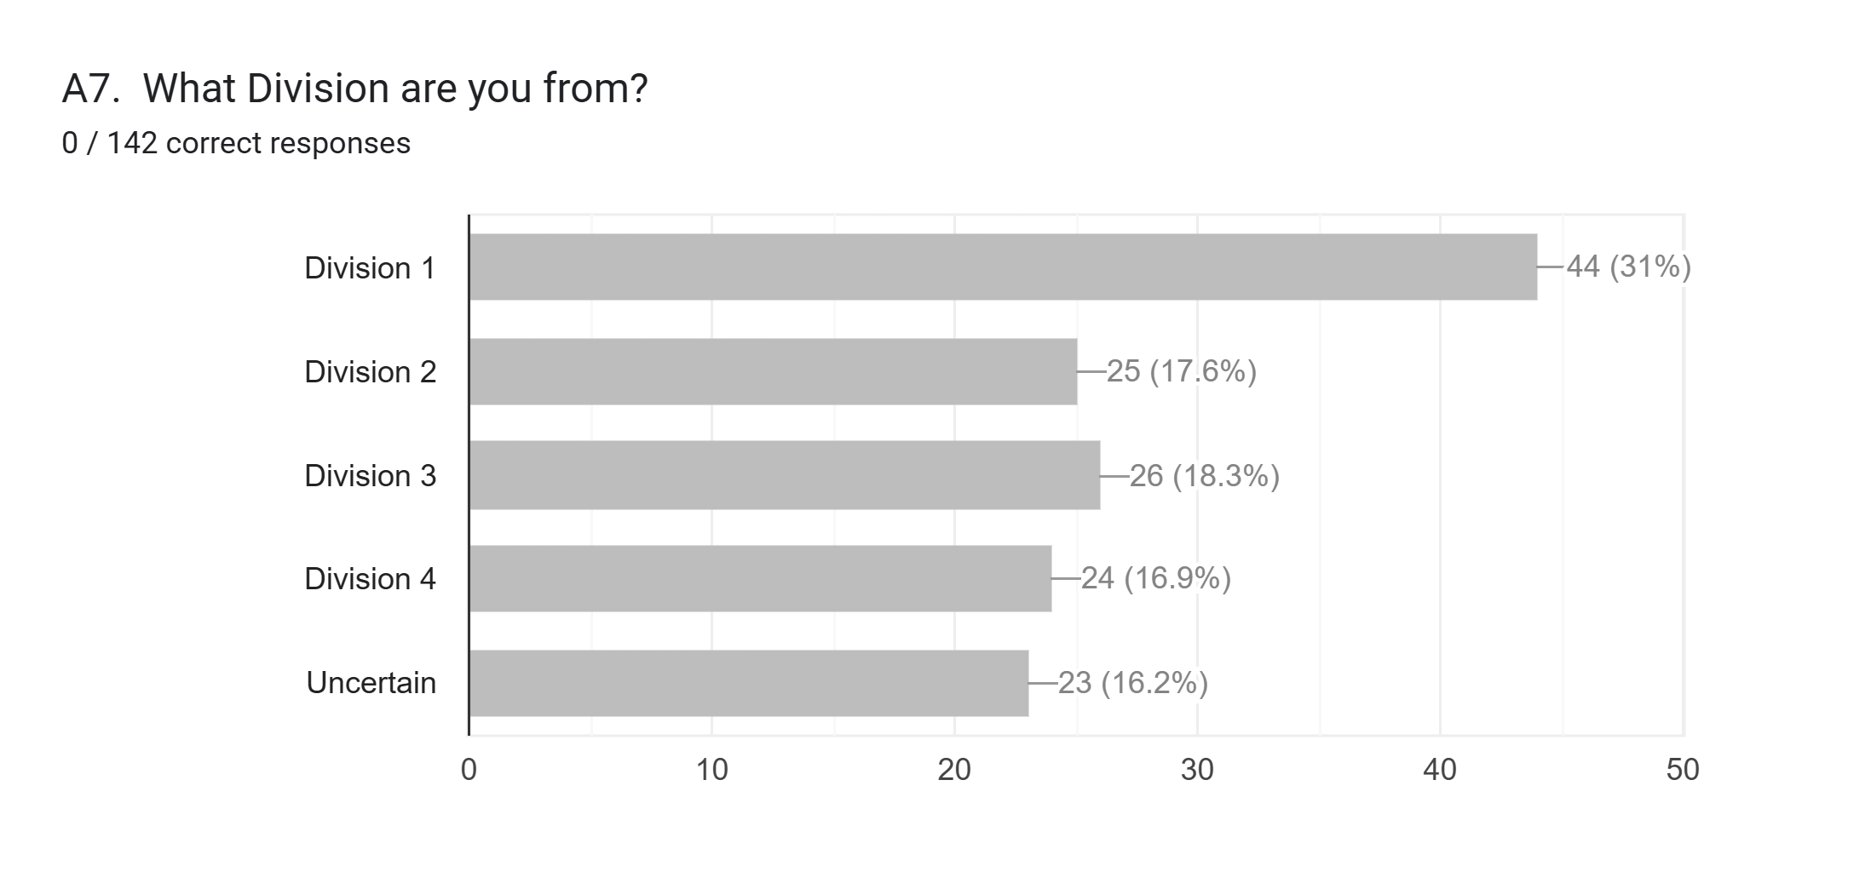
The American Legion, Department of Texas, Long Range Planning
* - 16% of the Posts do not know what Division they are aligned against.

Slide 5
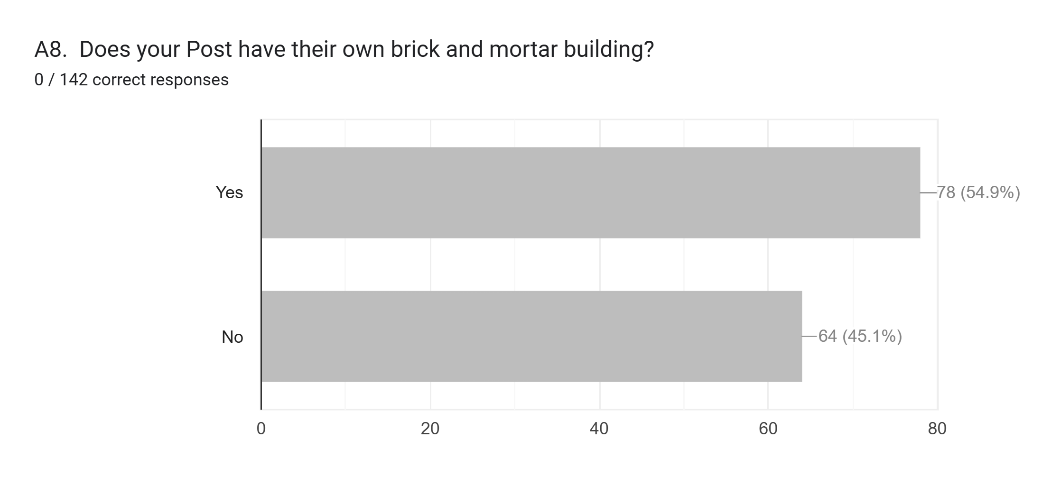
The American Legion, Department of Texas, Long Range Planning
* - 55% of the Posts have their own building to conduct American Legion business.

Slide 6
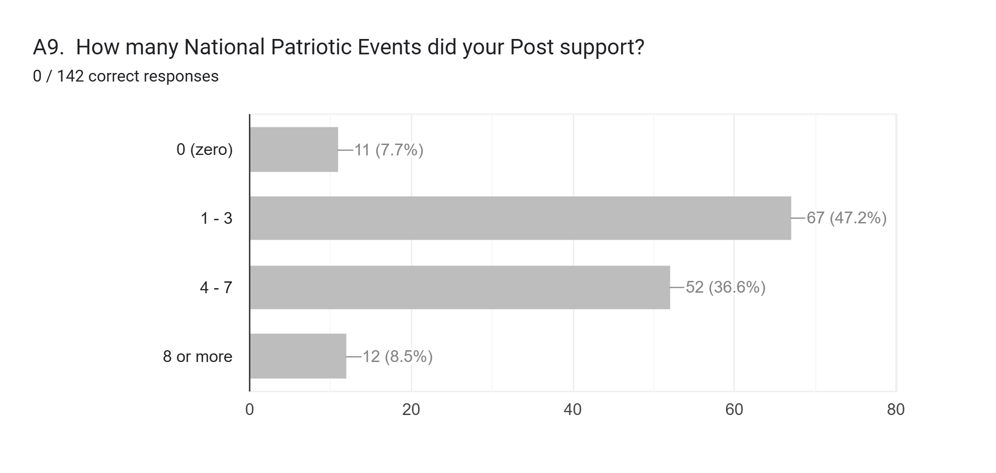
The American Legion, Department of Texas, Long Range Planning
* - 7.7% of the Posts did not participate in National Patriotic Events is 11 too many Post.

Slide 7
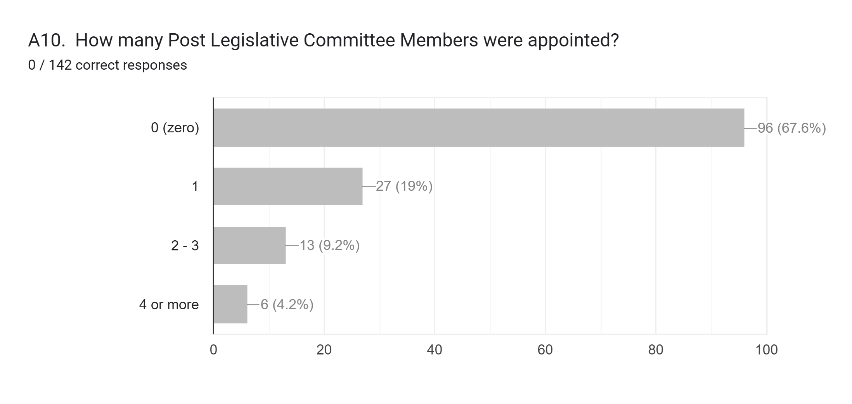
The American Legion, Department of Texas, Long Range Planning
* - The importance of these positions and their responsibilities is key to Post success.

Slide 8
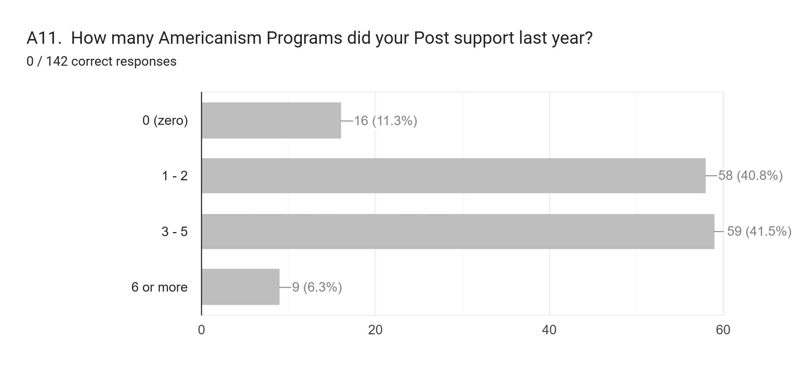
The American Legion, Department of Texas, Long Range Planning
* - 16 Posts need to have help from another Post in the District or District Staff OIP visit.

Slide 9
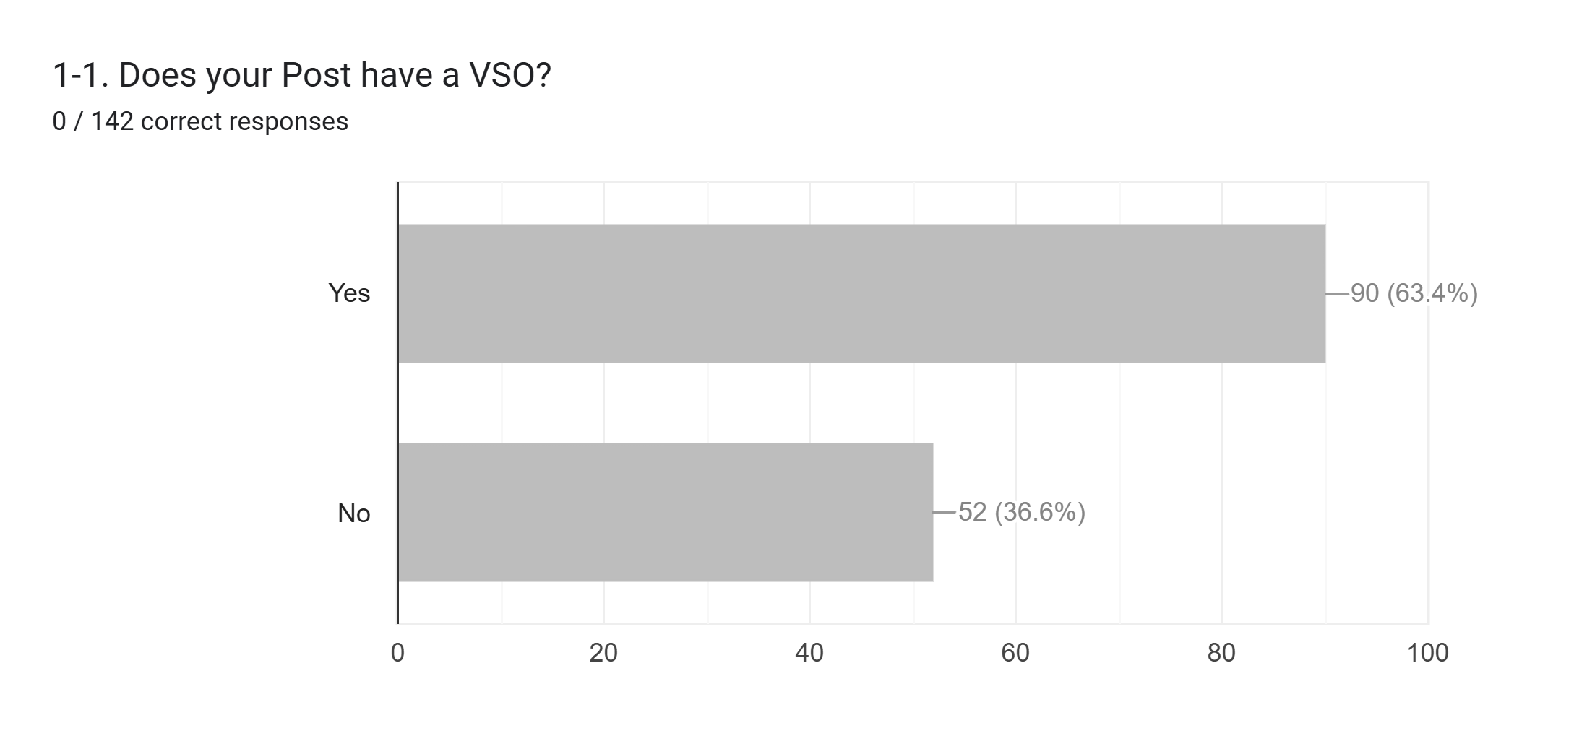
The American Legion, Department of Texas, Long Range Planning
* - If a Post does not have a VSO, how are their Veterans receiving the help they need?

Slide 10
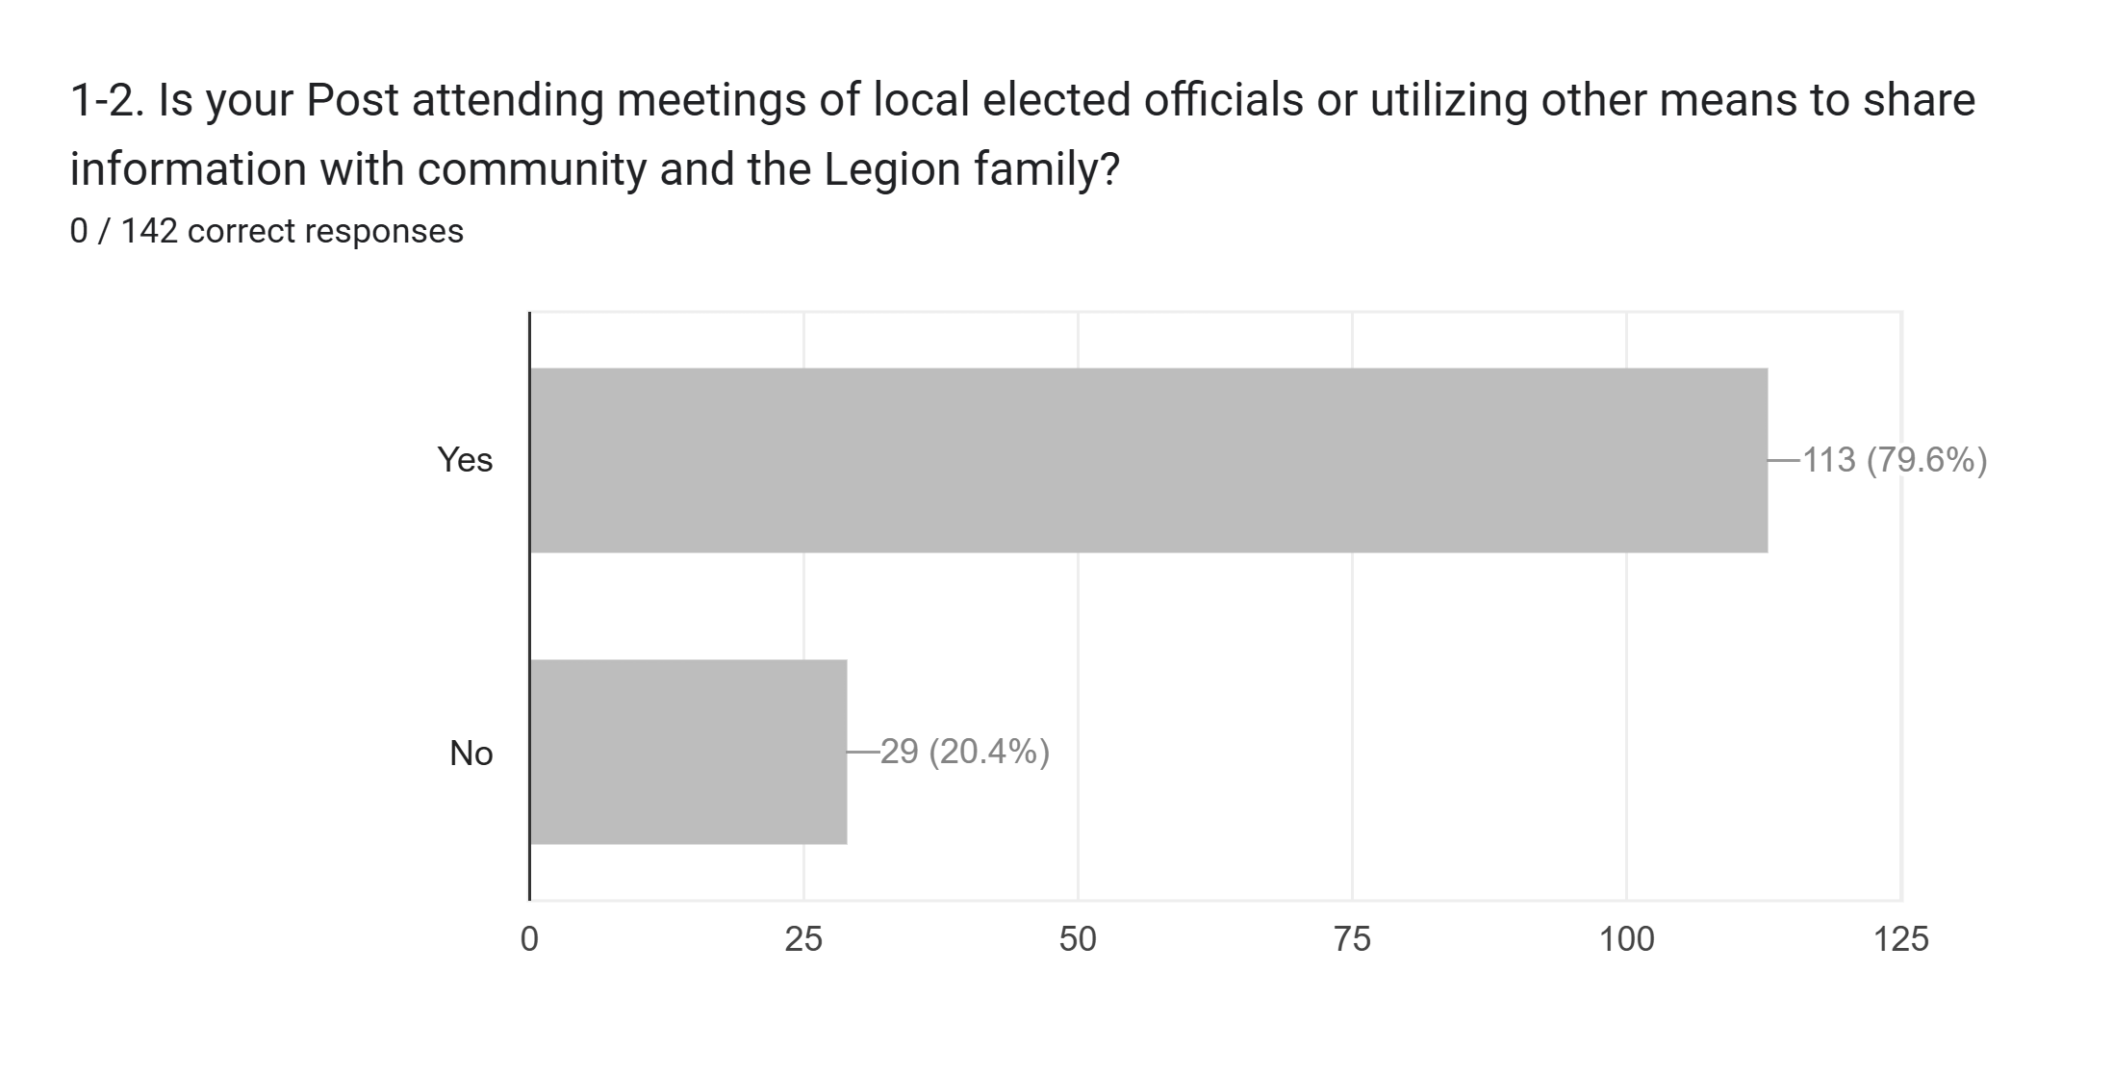
The American Legion, Department of Texas, Long Range Planning
* - Community, State and Nation….the smaller Posts appear to be involved.

Slide 11
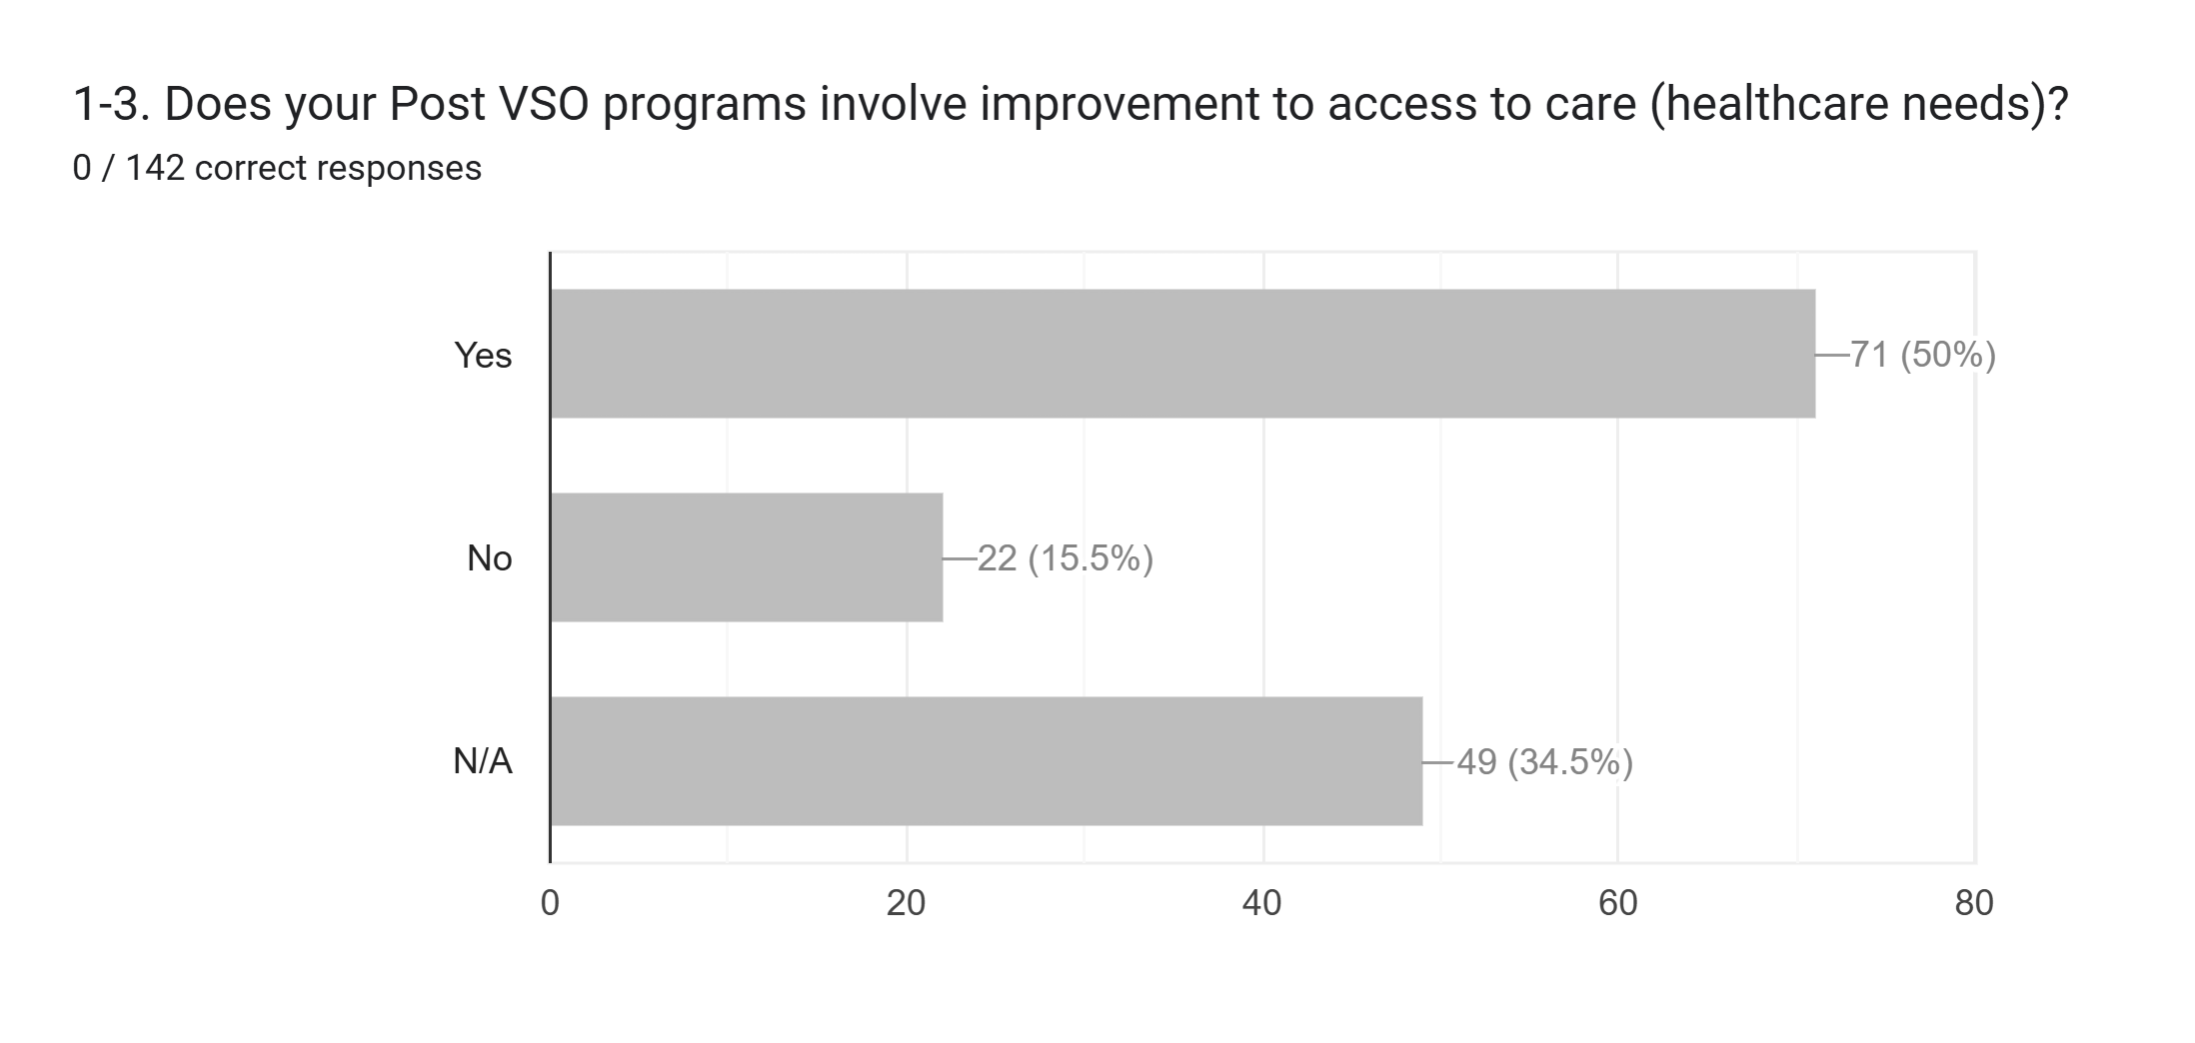
The American Legion, Department of Texas, Long Range Planning
* - Healthcare needs and access to care is a huge issue for Veterans, 50% of Post don’t address this.

Slide 12
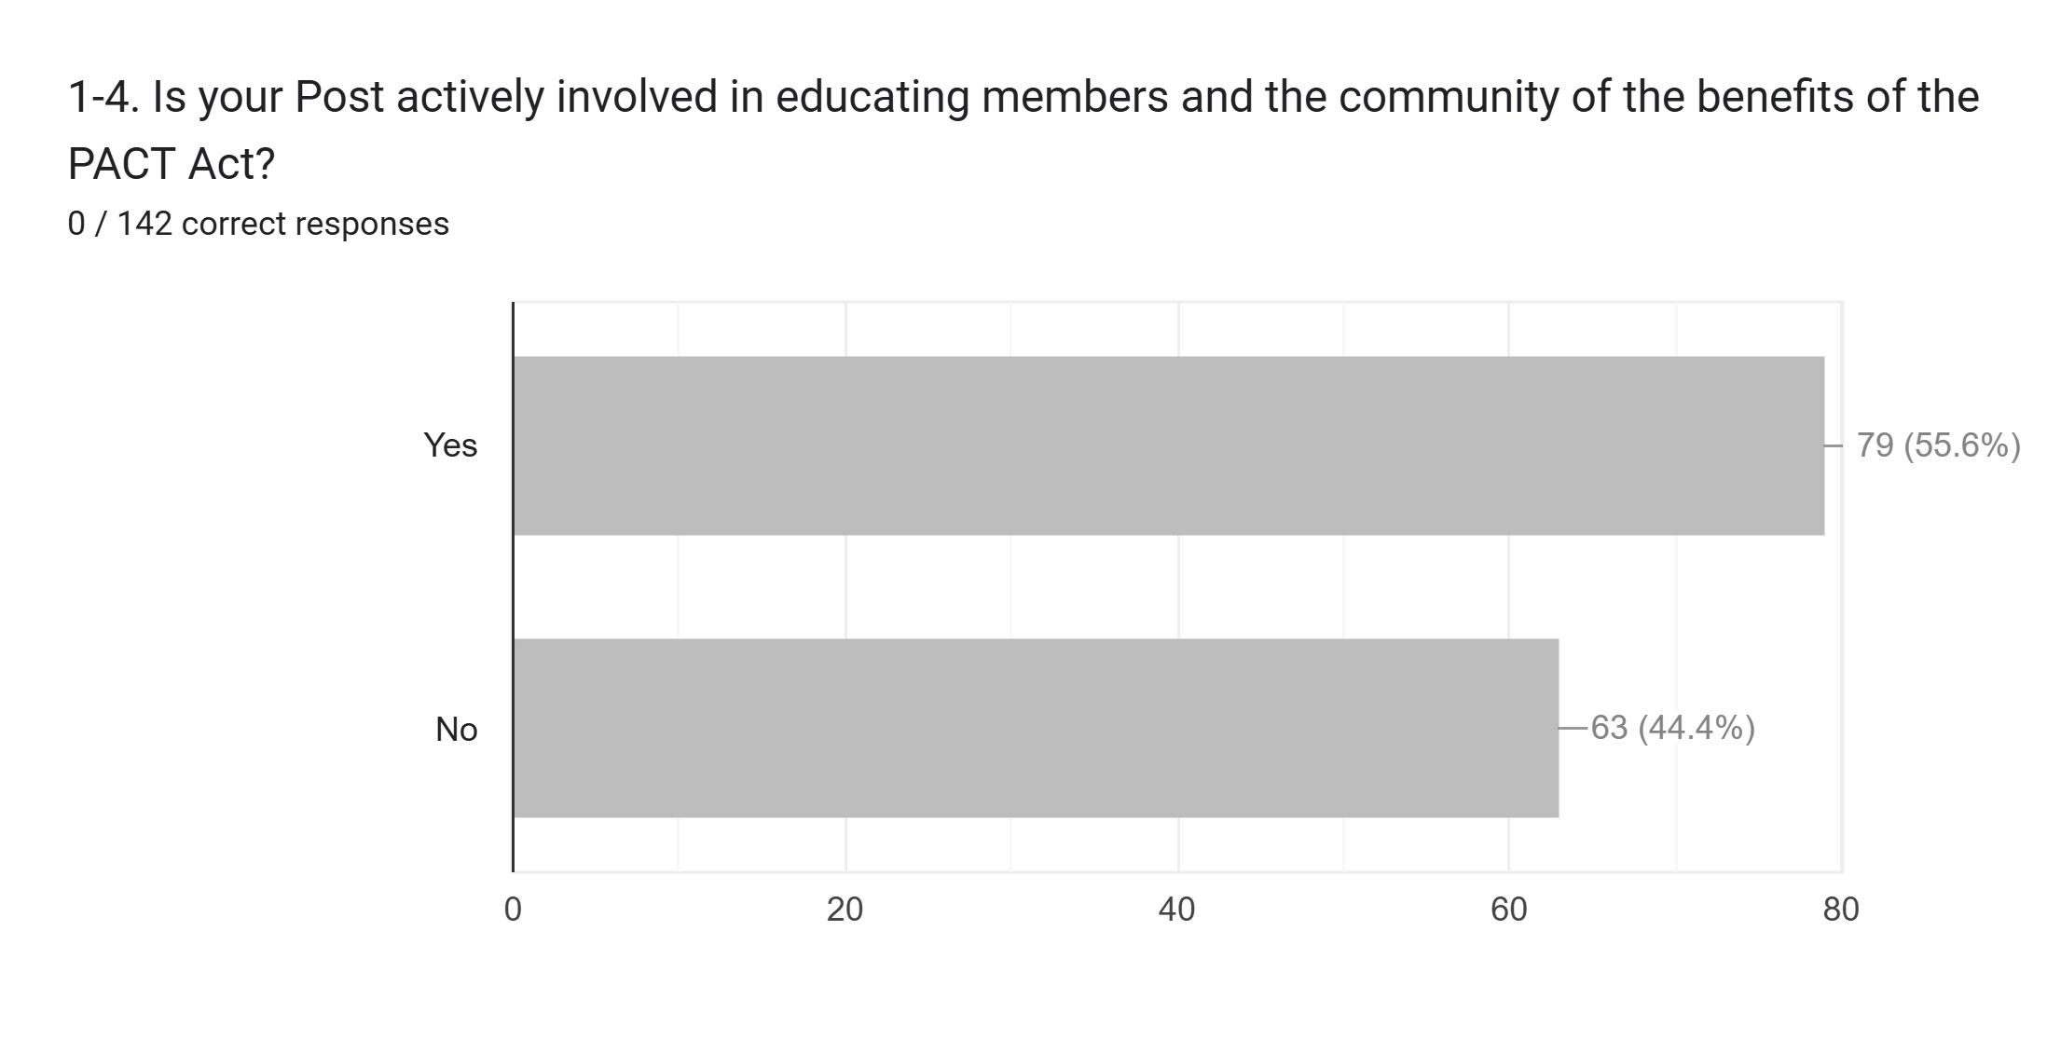
The American Legion, Department of Texas, Long Range Planning
* - Educating the public on PACT Act will most-likely help generate more memberships.

Slide 13
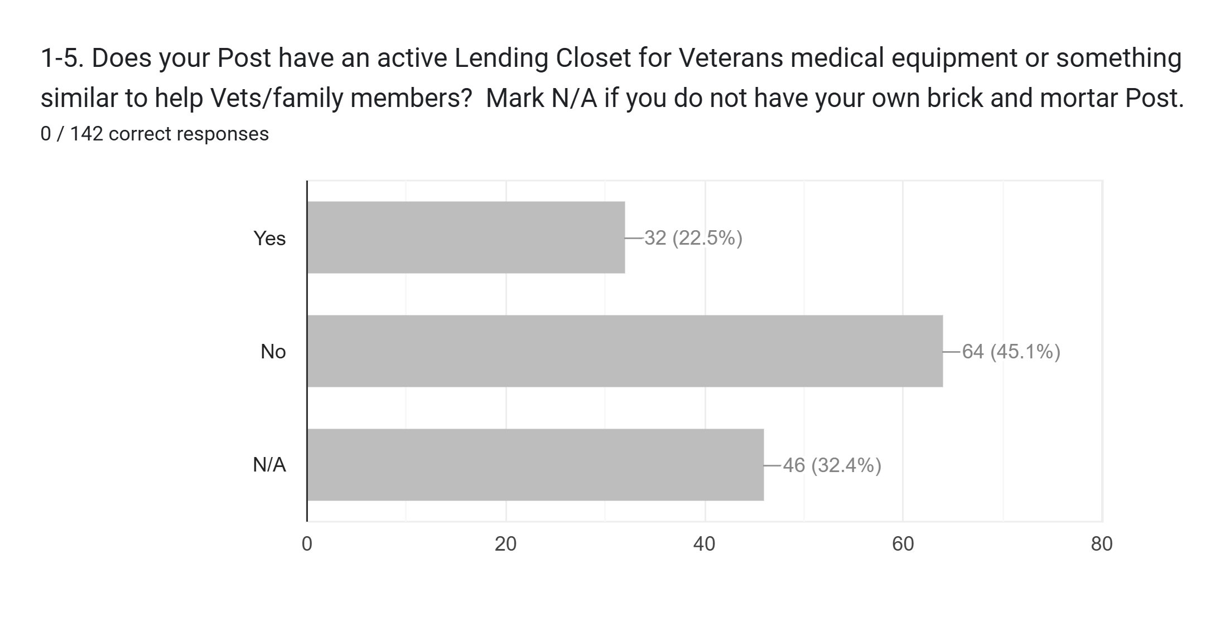
The American Legion, Department of Texas, Long Range Planning
* - 1/3rd of Posts with buildings are making sure med equipment is available. Check to see if the others have a different way to meet those same needs like coupling with VFWs, senior centers, etc. for the same type of support.

Slide 14
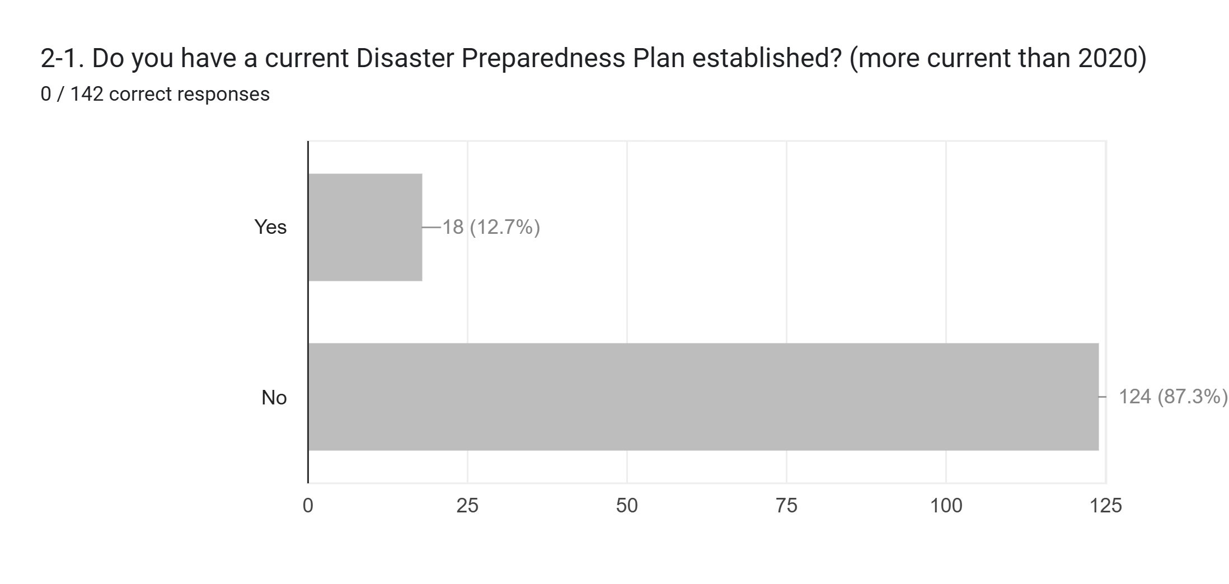
The American Legion, Department of Texas, Long Range Planning
* - This needs to be a program that has more attention at the District, Division and State levels.

Slide 15
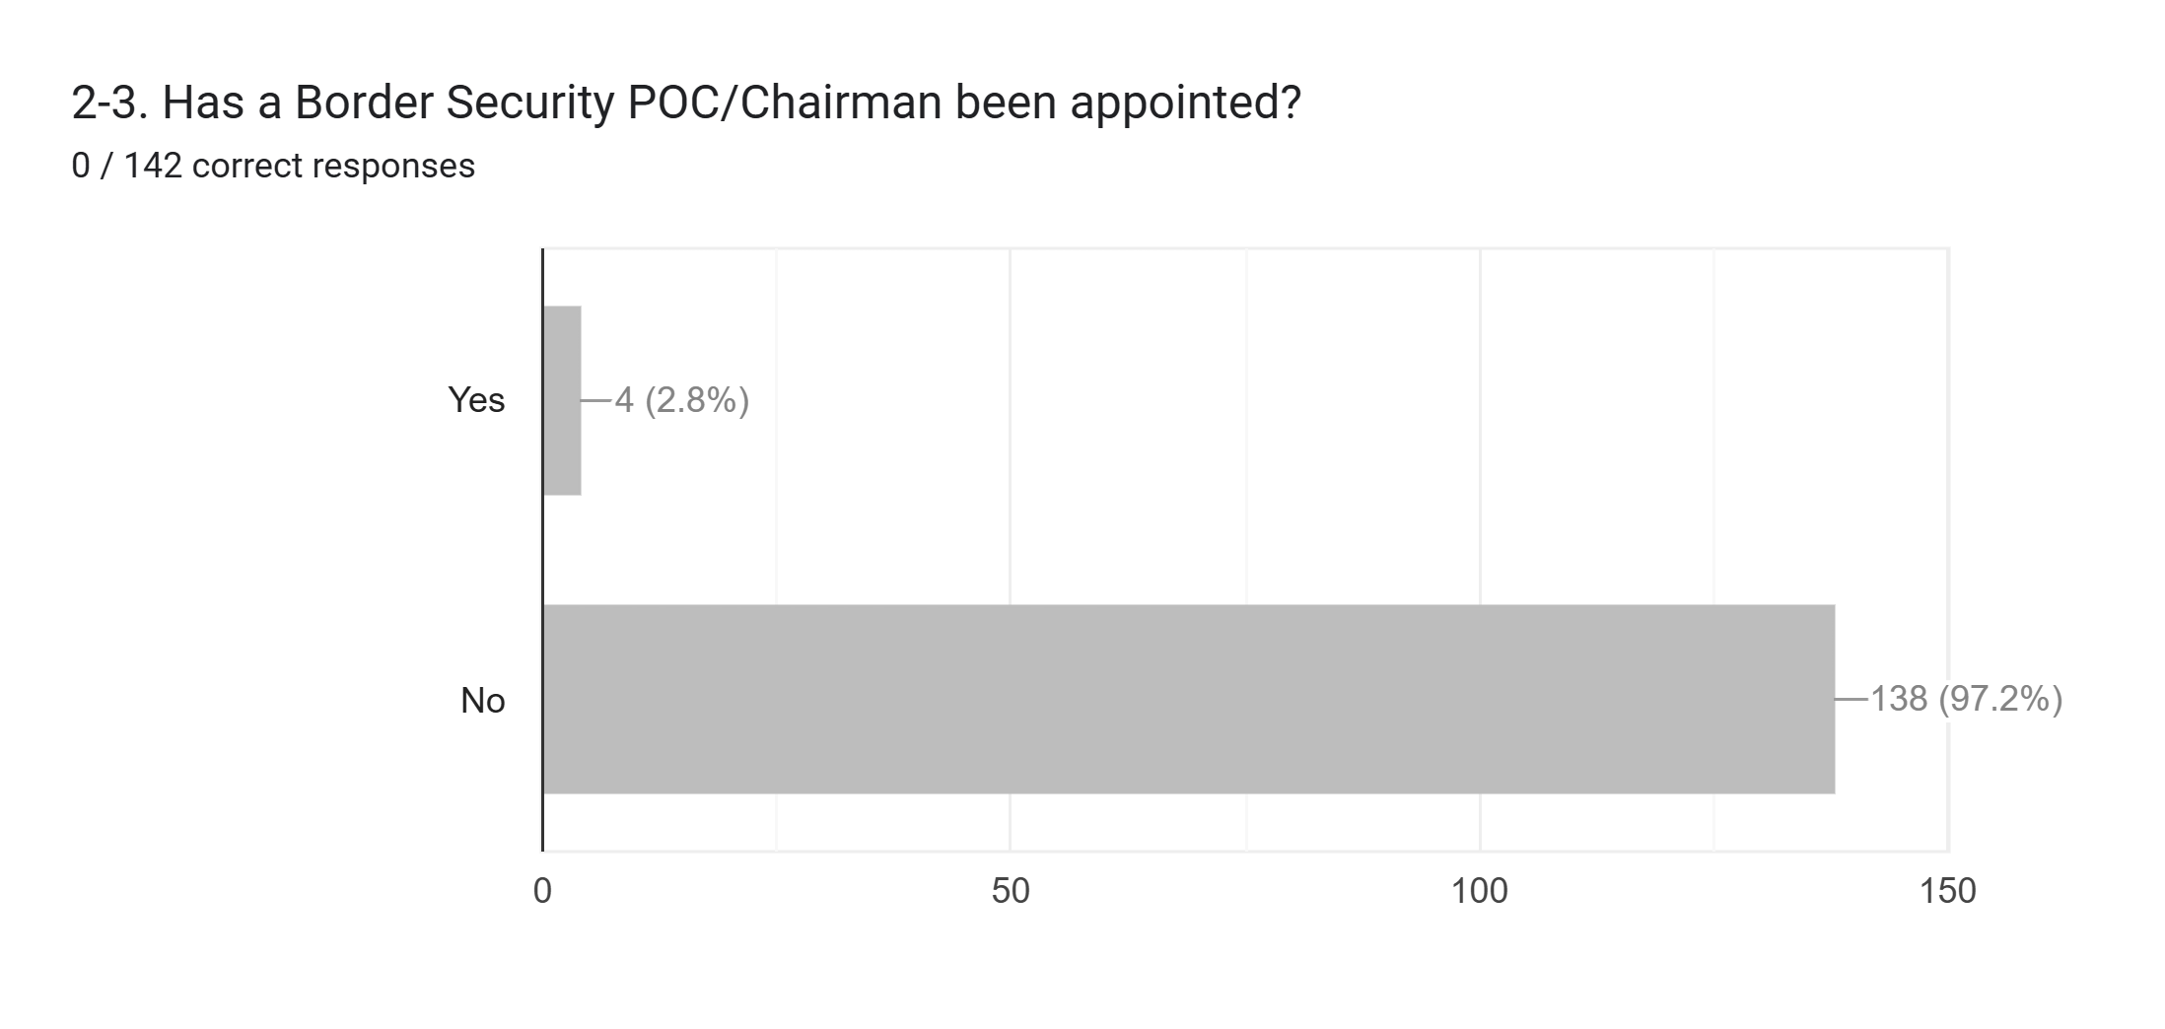
The American Legion, Department of Texas, Long Range Planning
* - Recommend an updated briefing by current or former District Cdr. Who briefed at Nationals in 2024.

Slide 16
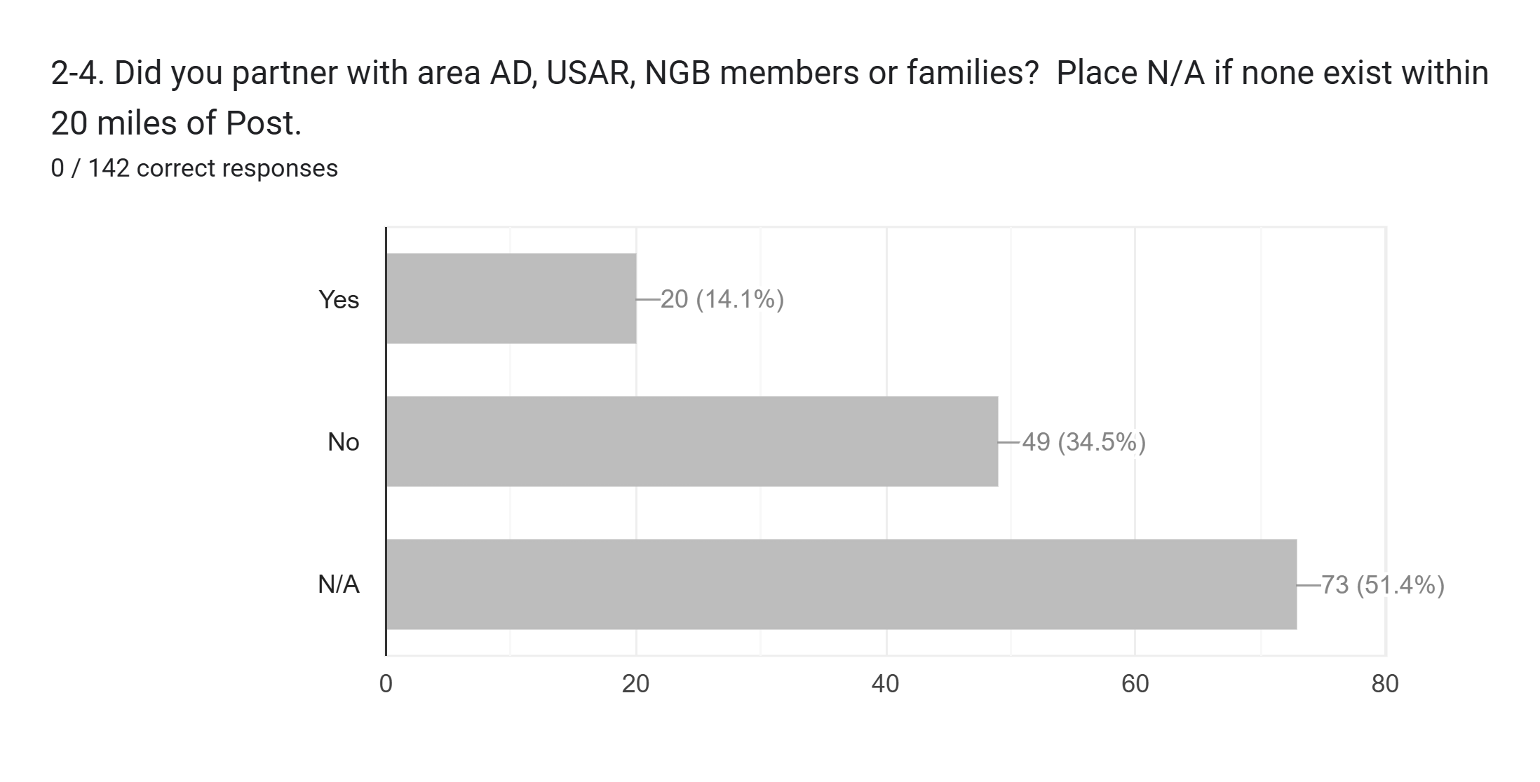
The American Legion, Department of Texas, Long Range Planning
* - Expected outcome since many Posts are not co-located with Military installations. Those who do have access should pull other District Posts into that support network.

Slide 17
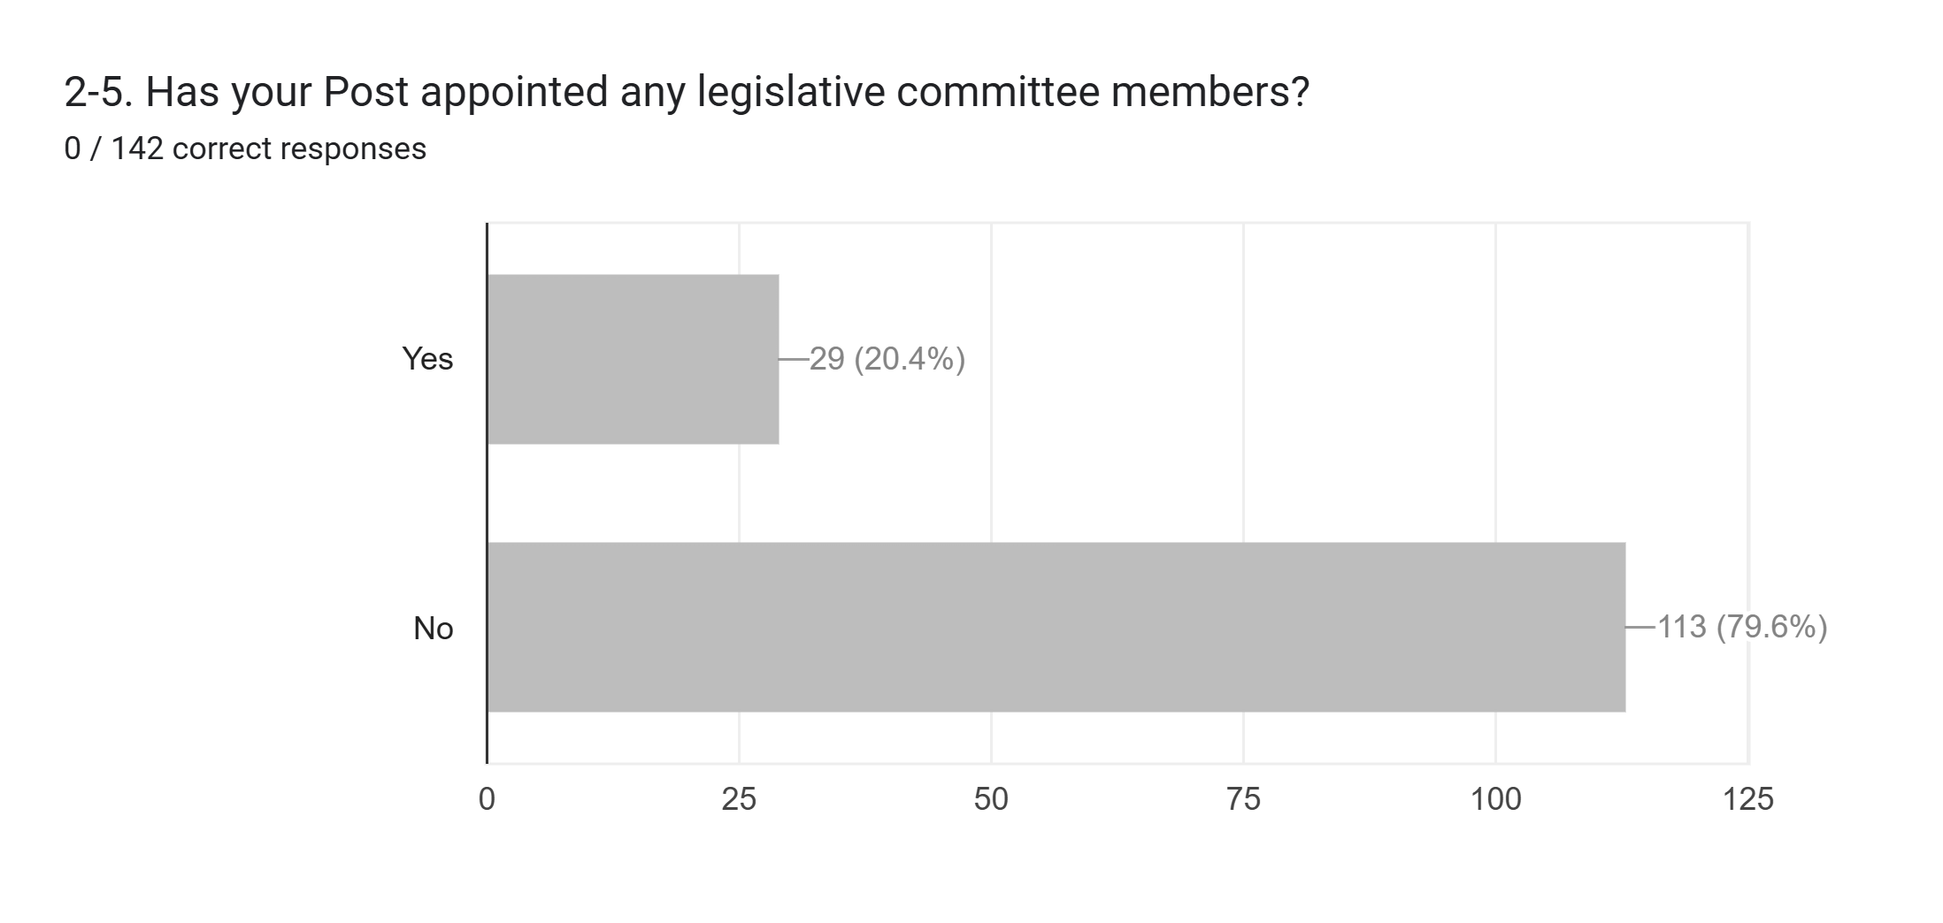
The American Legion, Department of Texas, Long Range Planning
* - Legislative Committee members are key to Post success.

Slide 18
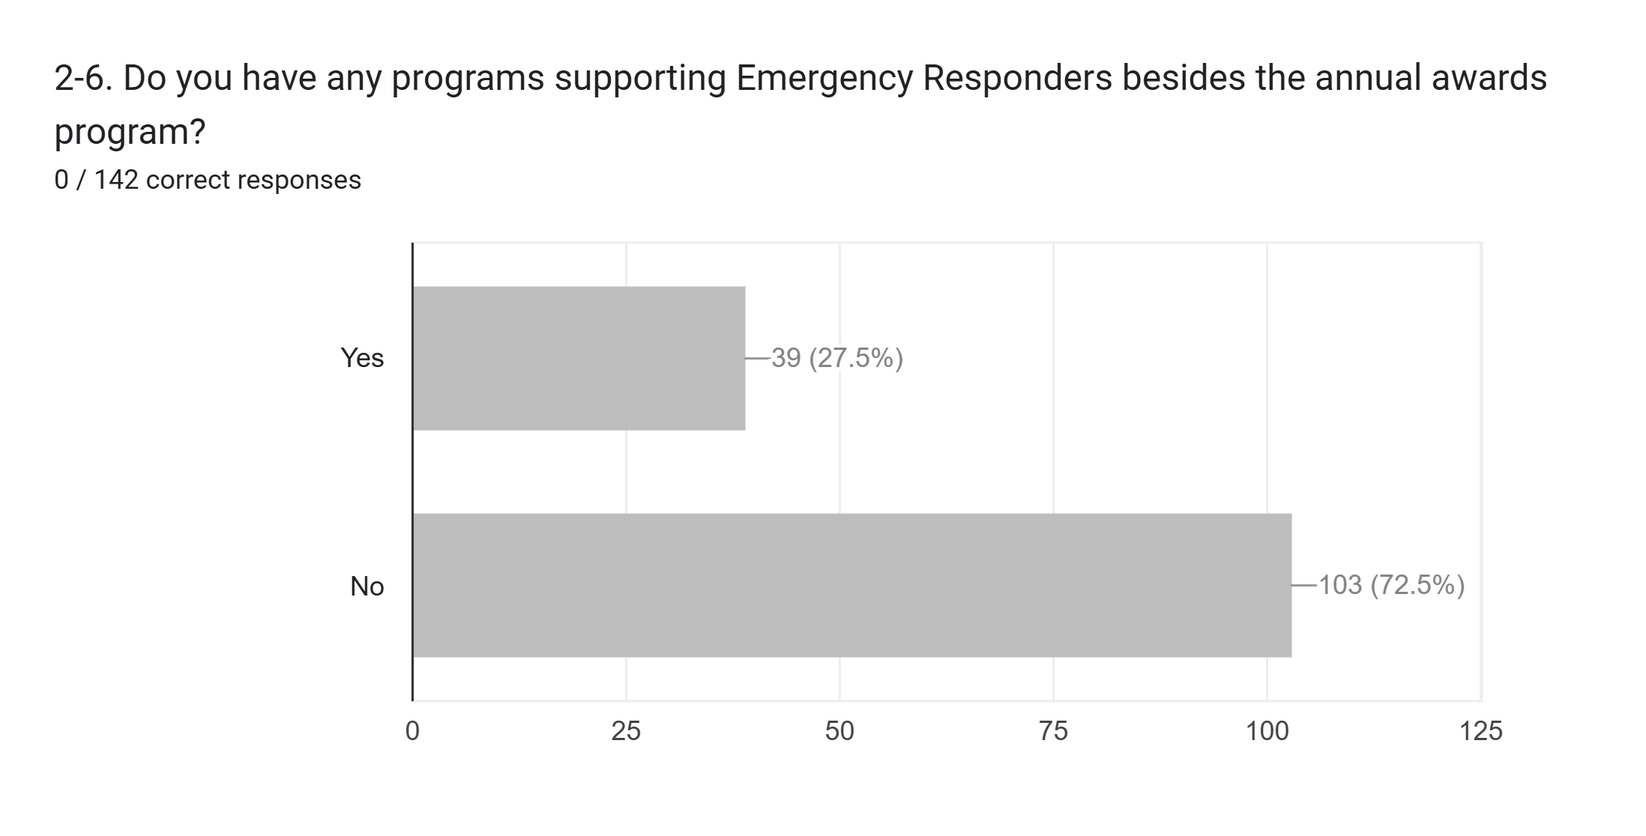
The American Legion, Department of Texas, Long Range Planning
* - Awards are avenue but offering support to those community entities will help grow better community support. Just offering free access to the Post for meetings of Police, Fire, or EMS may lead to some great gains.

Slide 19
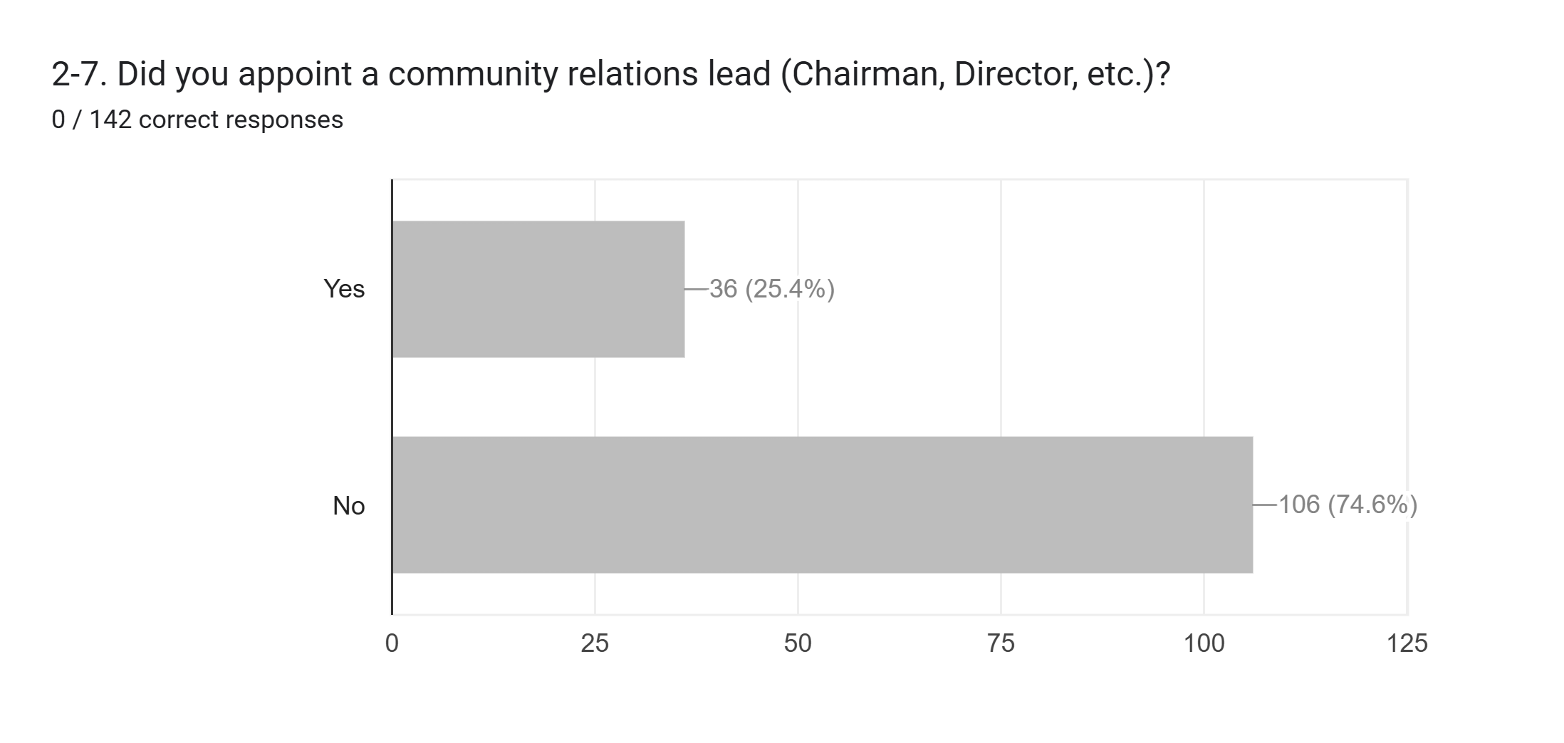
The American Legion, Department of Texas, Long Range Planning
* - Just having one person appointed as Chairman and attending meetings with city will lead to higher intake of new members.

Slide 20
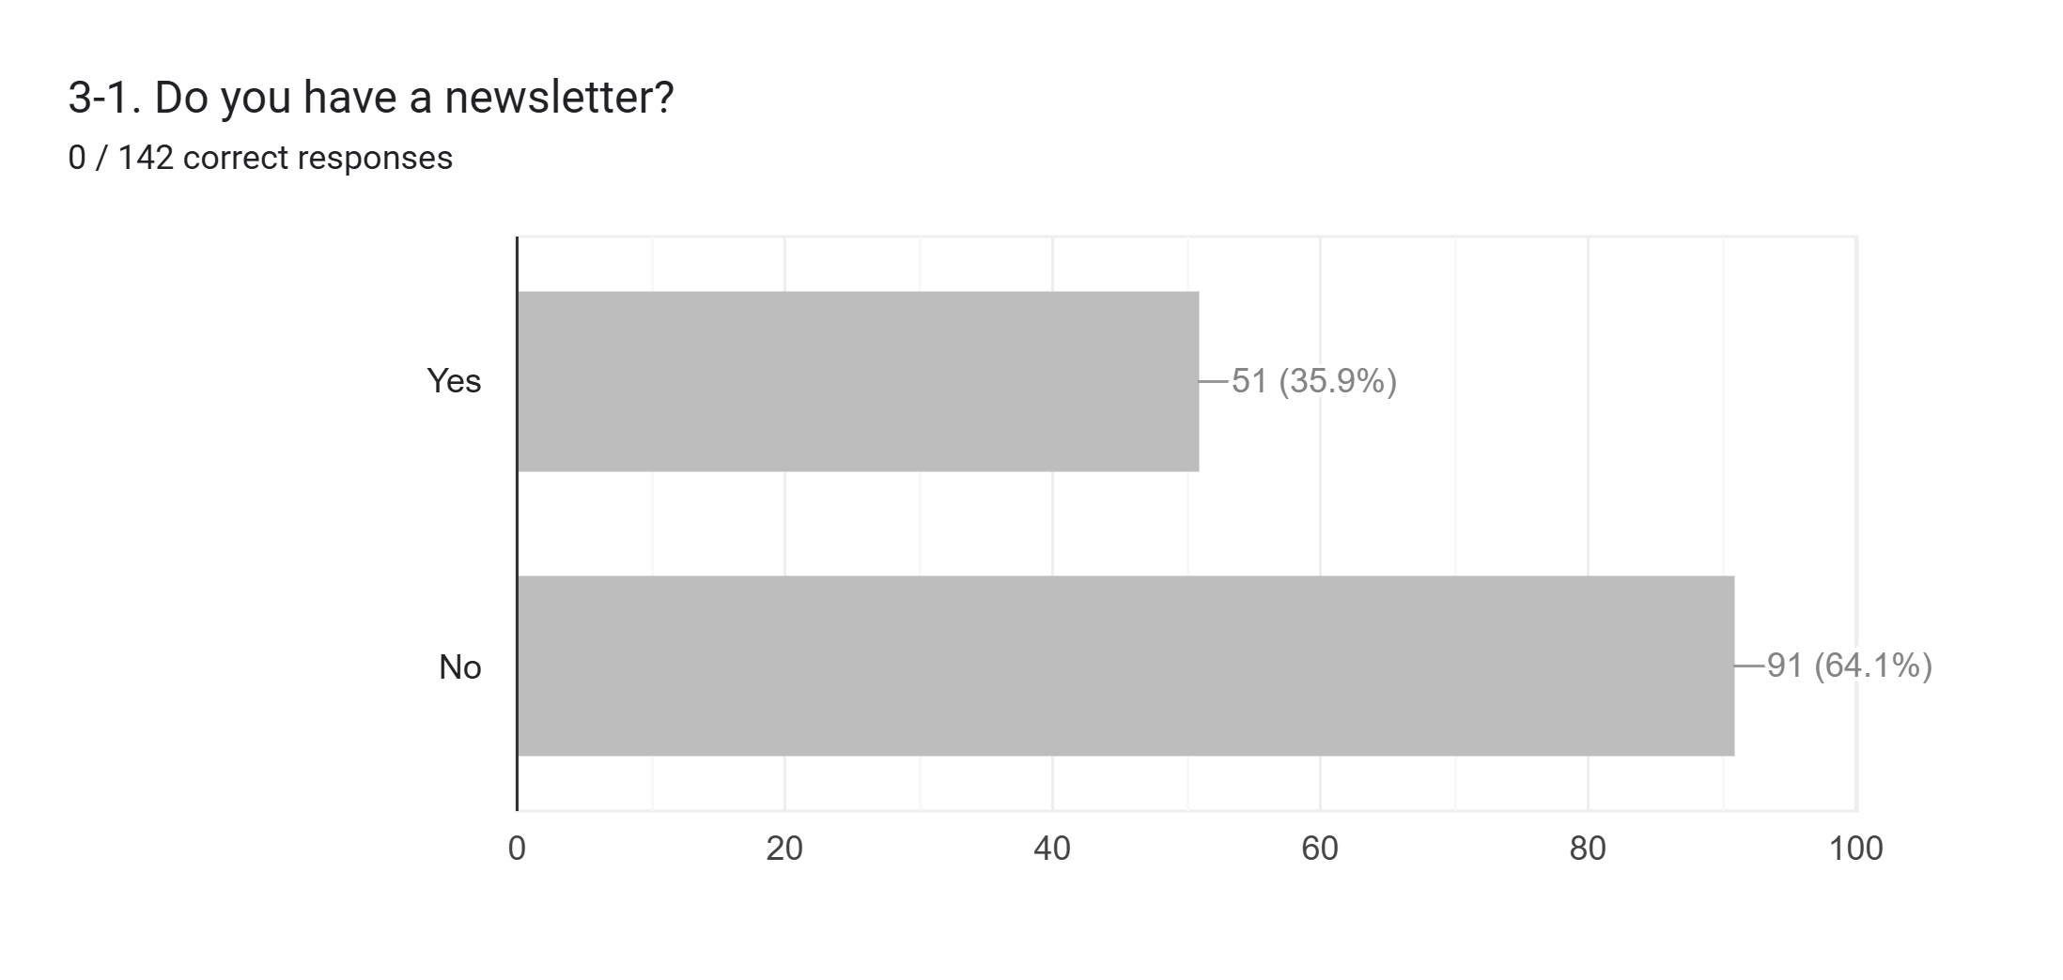
The American Legion, Department of Texas, Long Range Planning
* - Wow, I assumed this would be 100%. E-newsletter is cost effective and helps with retention, membership numbers, and participation/support of activities. Key to any Post’s success.

Slide 21
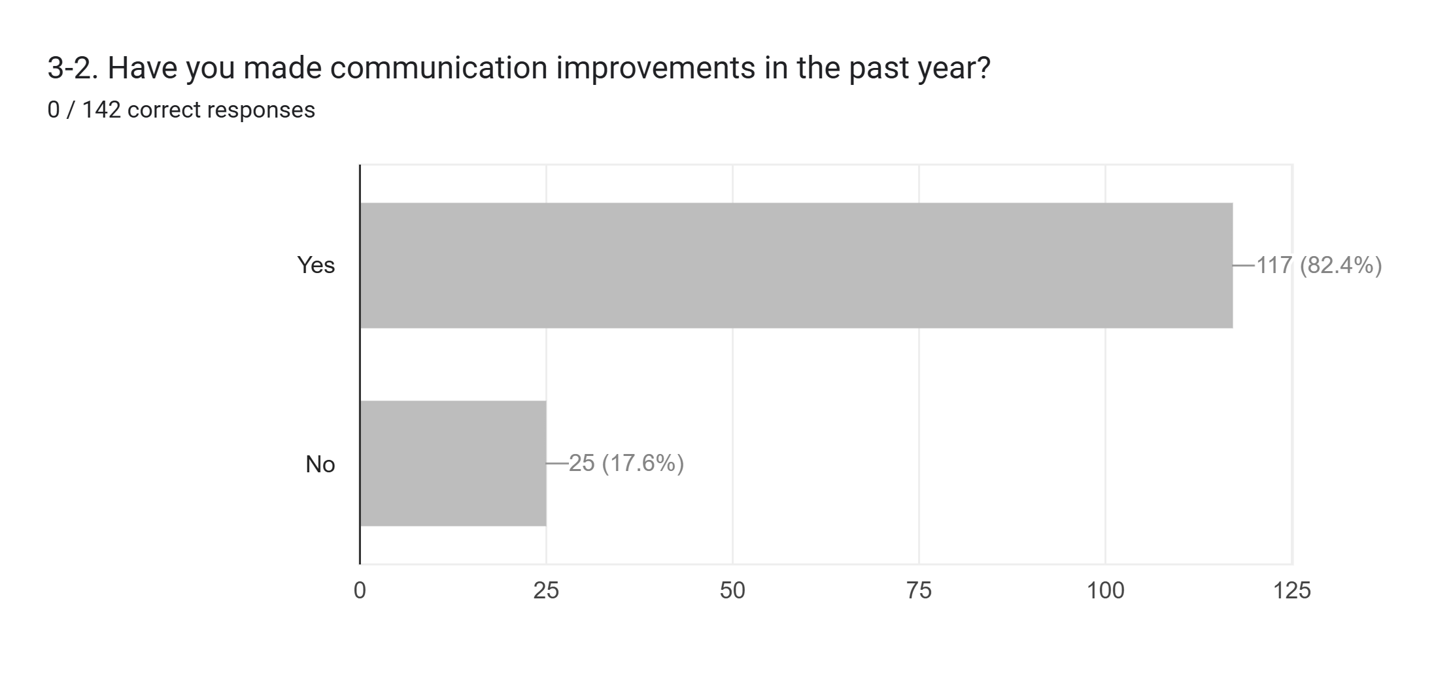
The American Legion, Department of Texas, Long Range Planning
* - Great stats but this is from the Post themselves, District oversight of progress still needed.

Slide 22
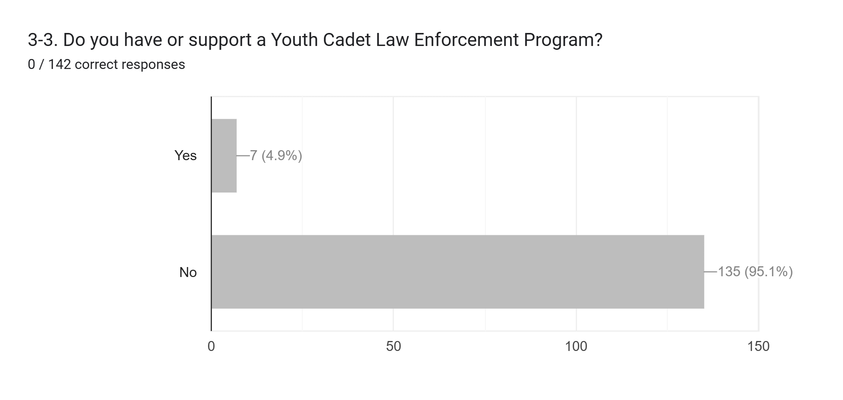
The American Legion, Department of Texas, Long Range Planning
* - Program for Youth and community involvement. Could lead to higher membership numbers.

Slide 23
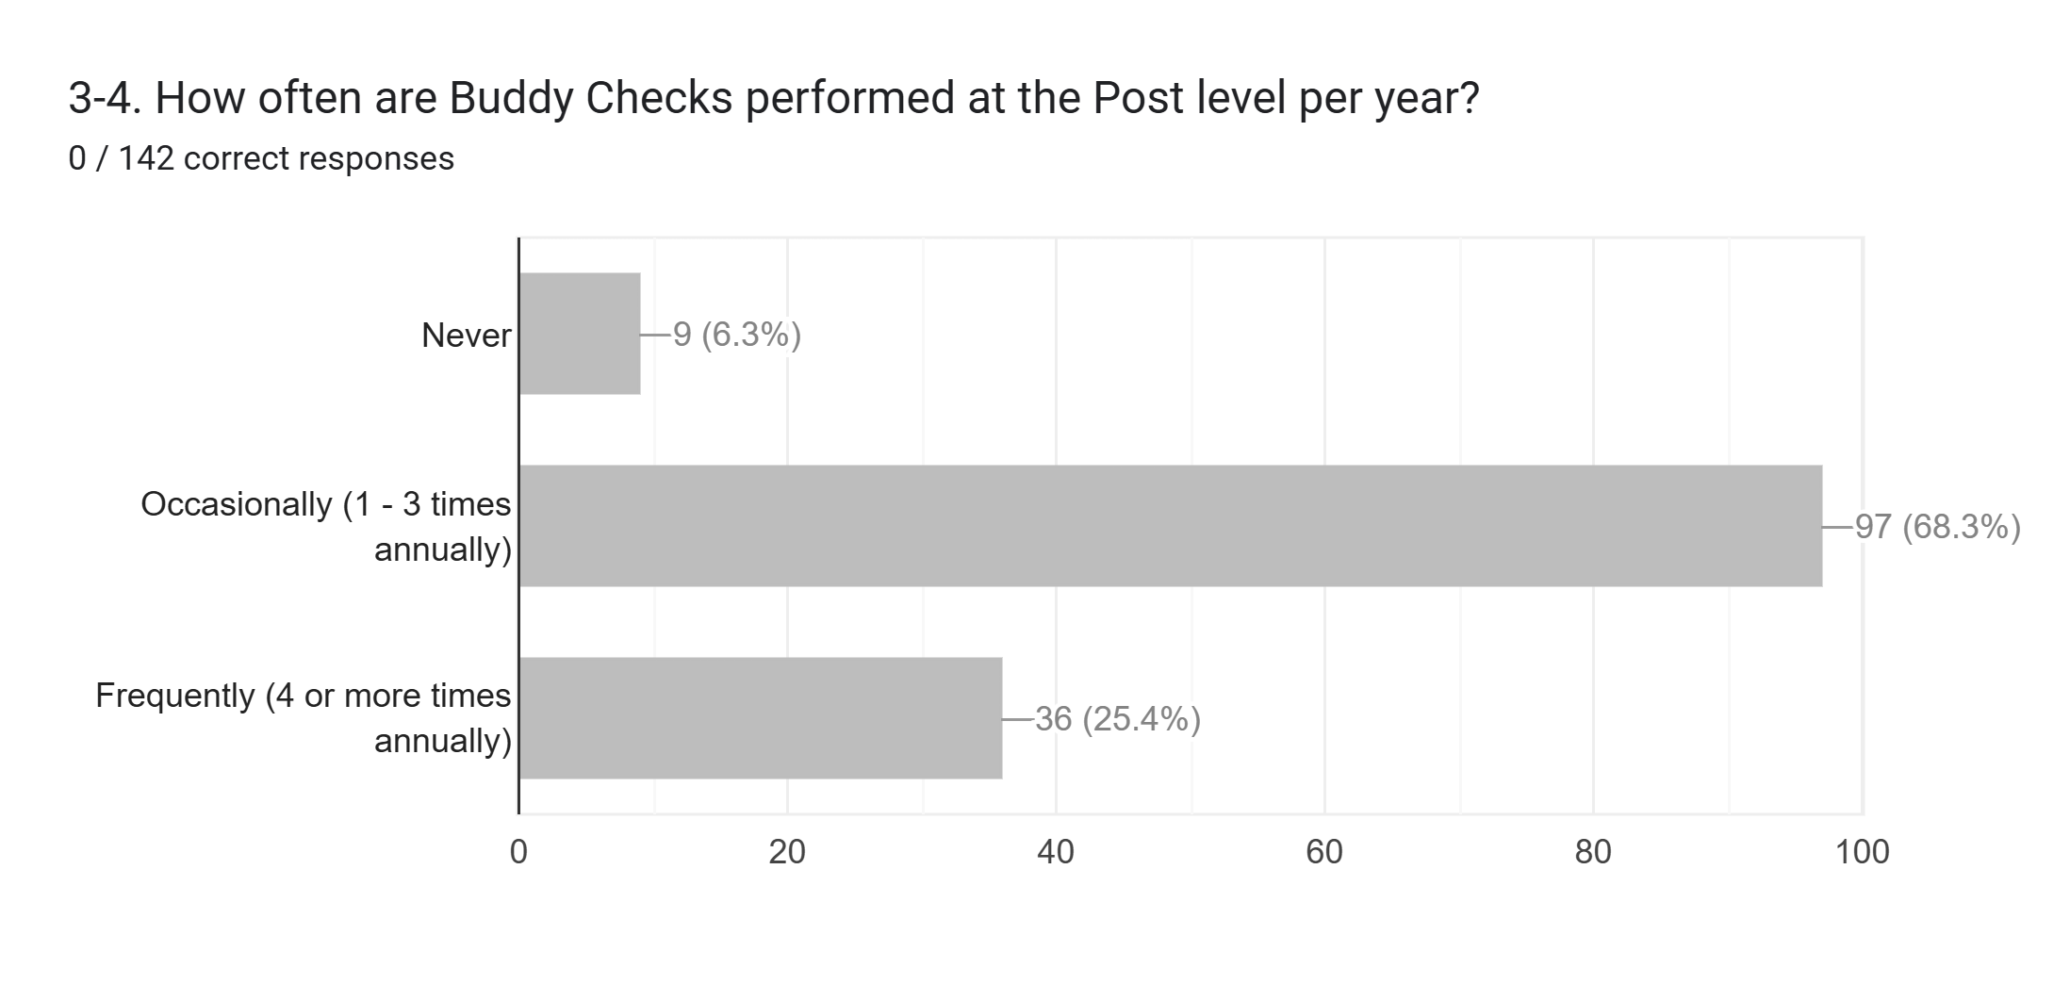
The American Legion, Department of Texas, Long Range Planning
* - Concern for those 9 that listed NEVER. If you did have them and members are not aware, then a quick change to the communication to members will improve the perception of this program. District oversight required.

Slide 24
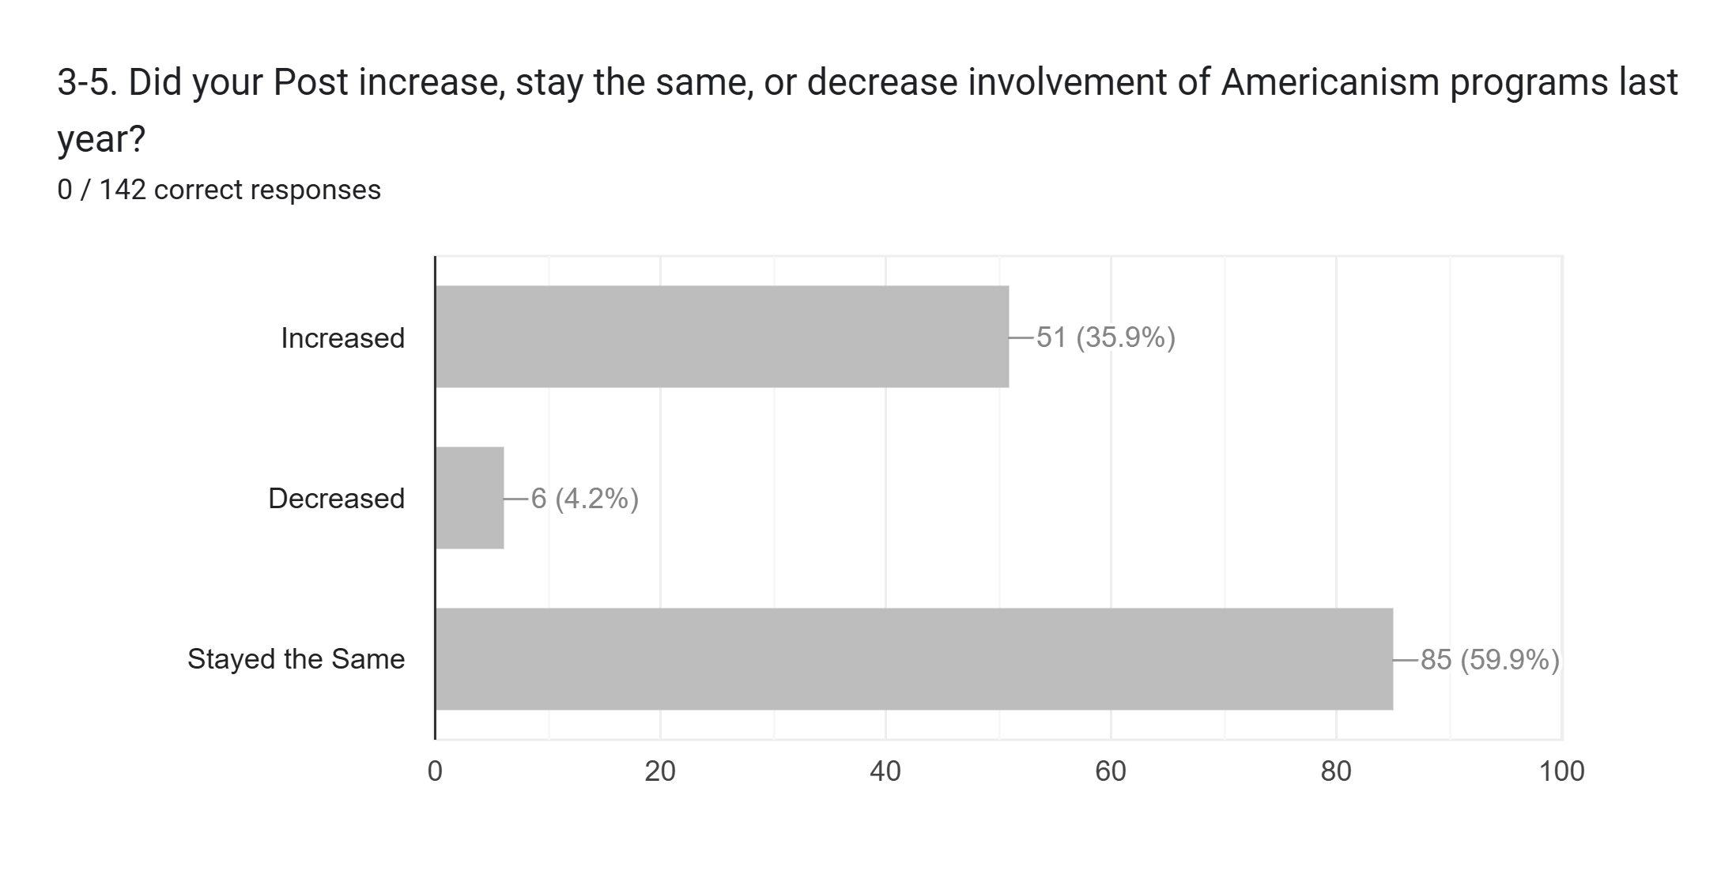
The American Legion, Department of Texas, Long Range Planning
* - Kudos to the current group of Post Commanders.

Slide 25
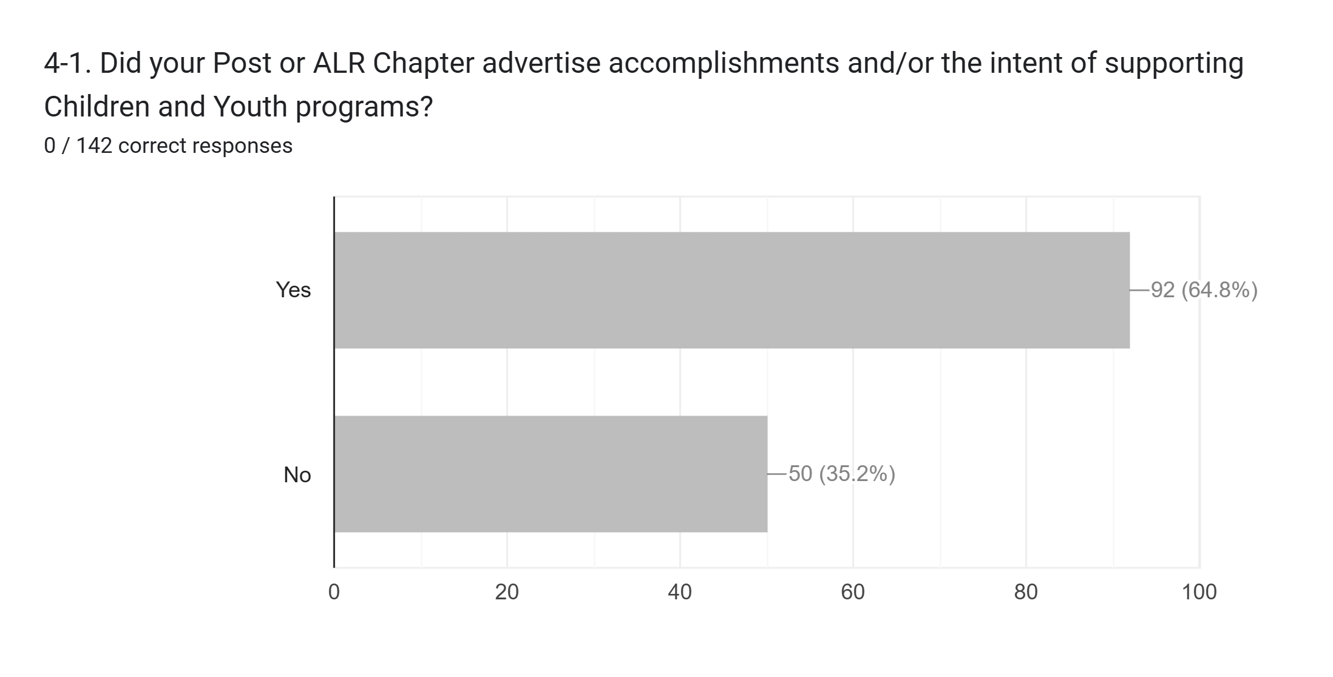
The American Legion, Department of Texas, Long Range Planning
* - The Children and Youth Foundation is the new State program that ALR is supporting and Posts should help by incorporating their fundraisers for the same reason.

Slide 26
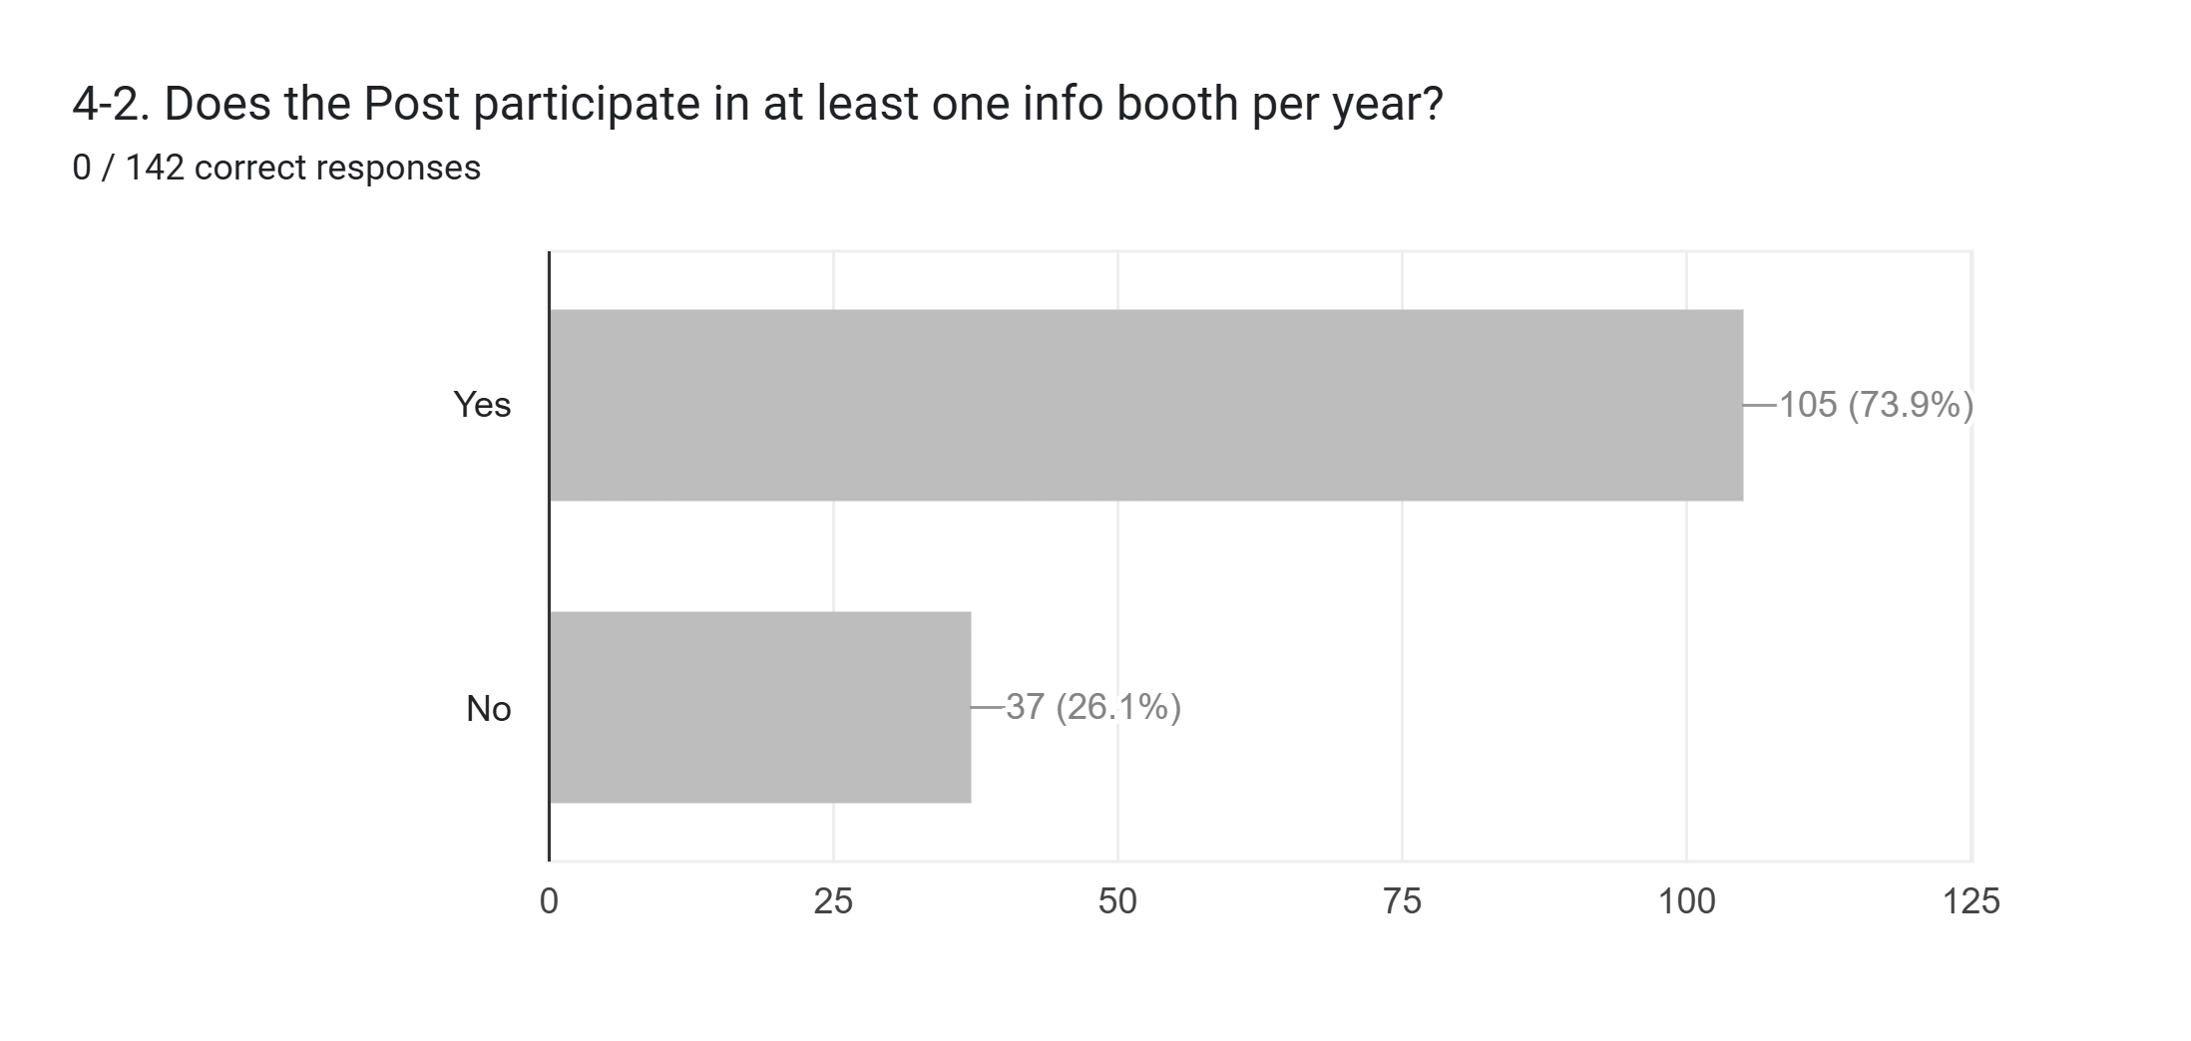
The American Legion, Department of Texas, Long Range Planning
* - Key to selling the benefits of being part of the American Legion Family.

Slide 27
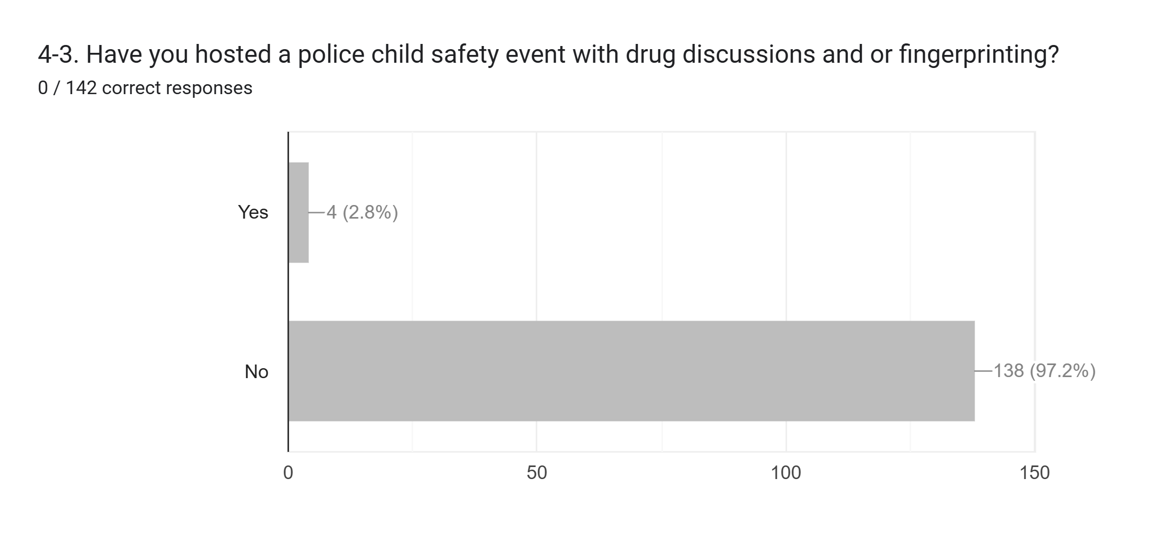
The American Legion, Department of Texas, Long Range Planning
* - Recommend one of the 4 Posts provide a training session on their program during Fall DEC.

Slide 28
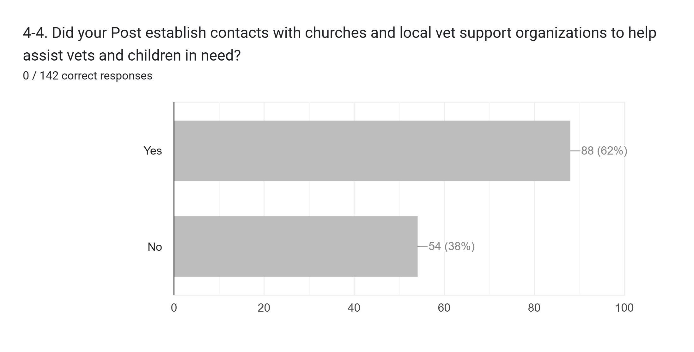
The American Legion, Department of Texas, Long Range Planning
* - A great initiative for some of your non-active members who are actively involved with the church.

Slide 29
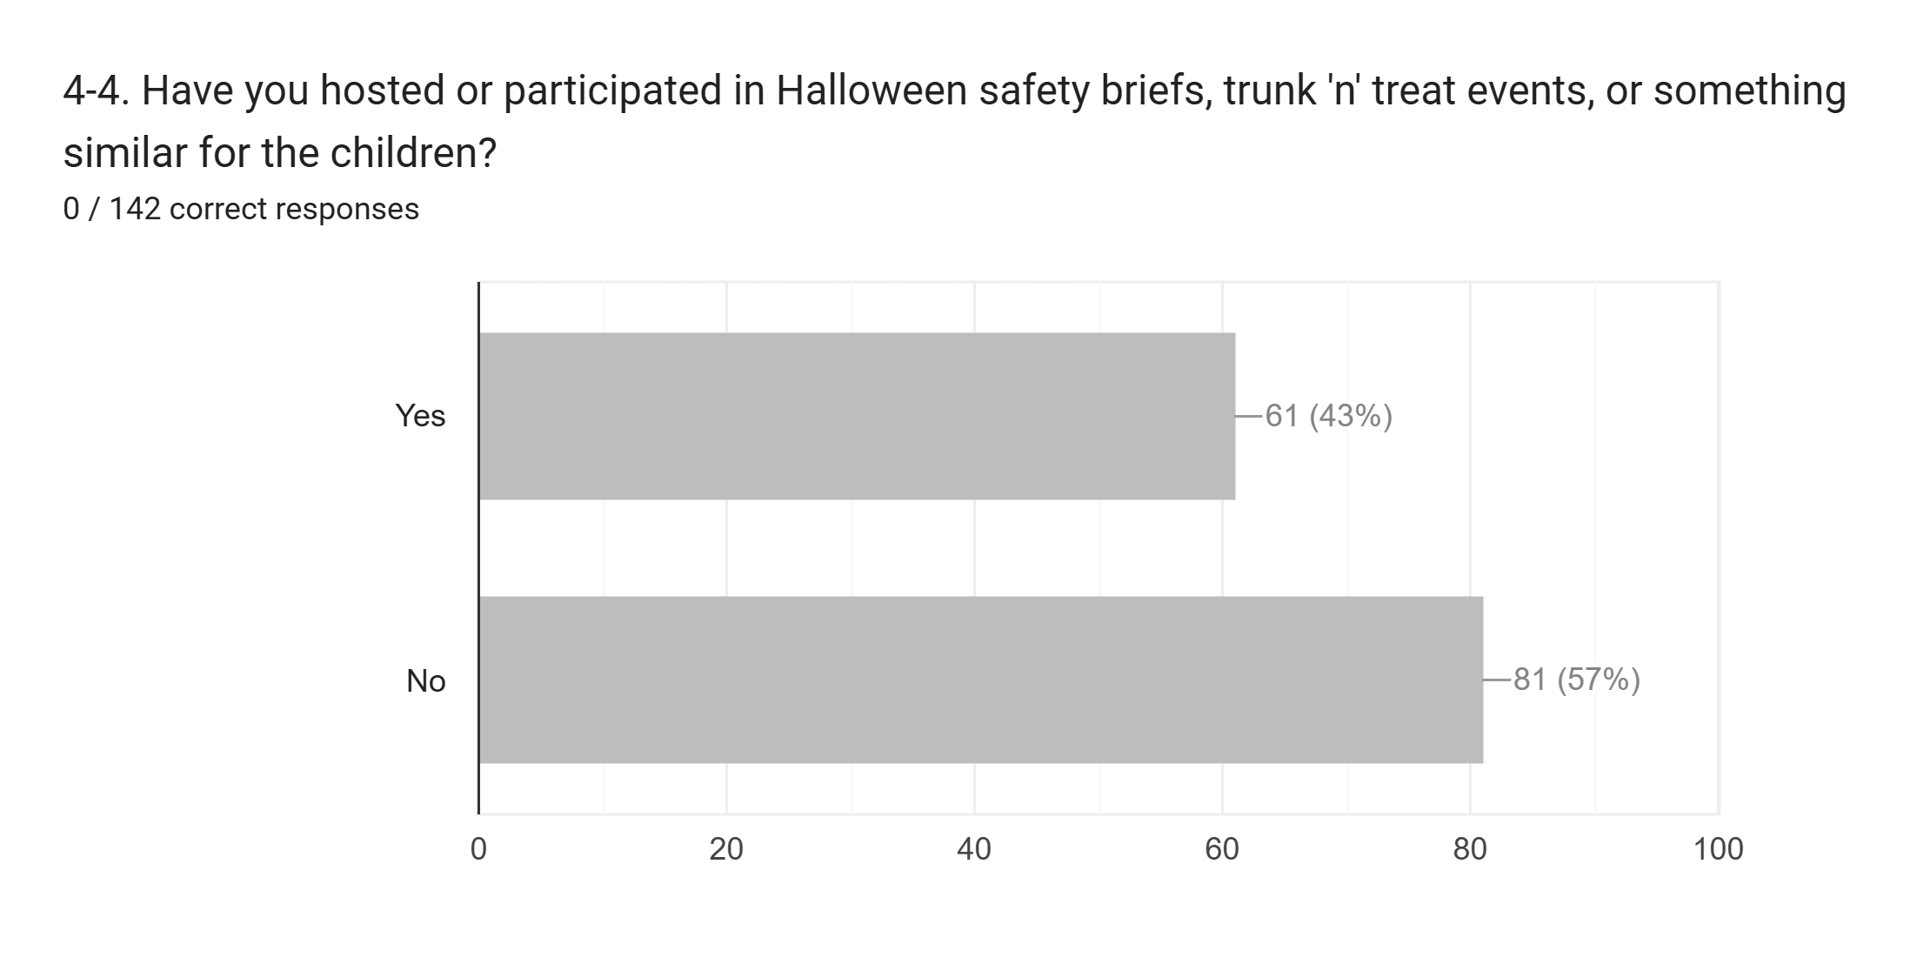
The American Legion, Department of Texas, Long Range Planning
* - I would have expected more but age demographics is probably why numbers are low…but grandchildren are also part of our future and safety of all children is a core responsibility of our Posts.

Slide 30
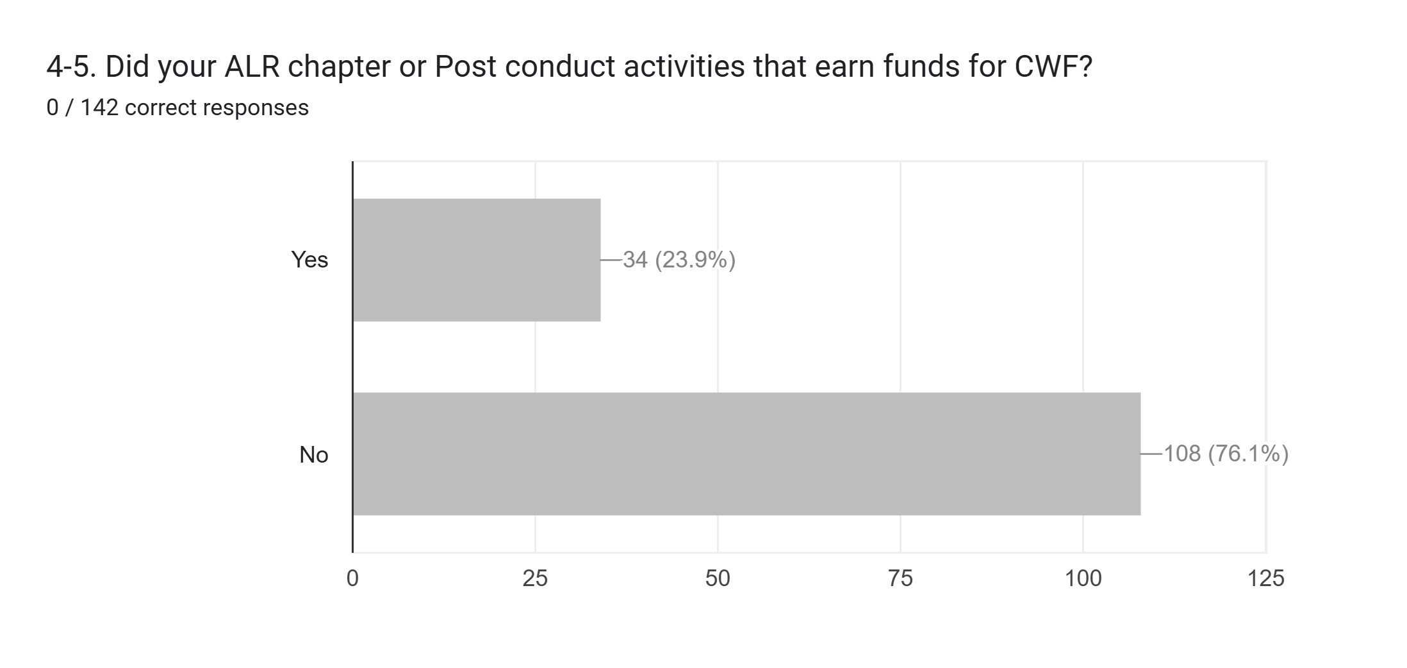
The American Legion, Department of Texas, Long Range Planning
* - The Children and Youth Foundation is a relatively new State program that ALR is supporting and Posts should help by incorporating their fundraiseing efforts into that of the ALR.

Slide 31
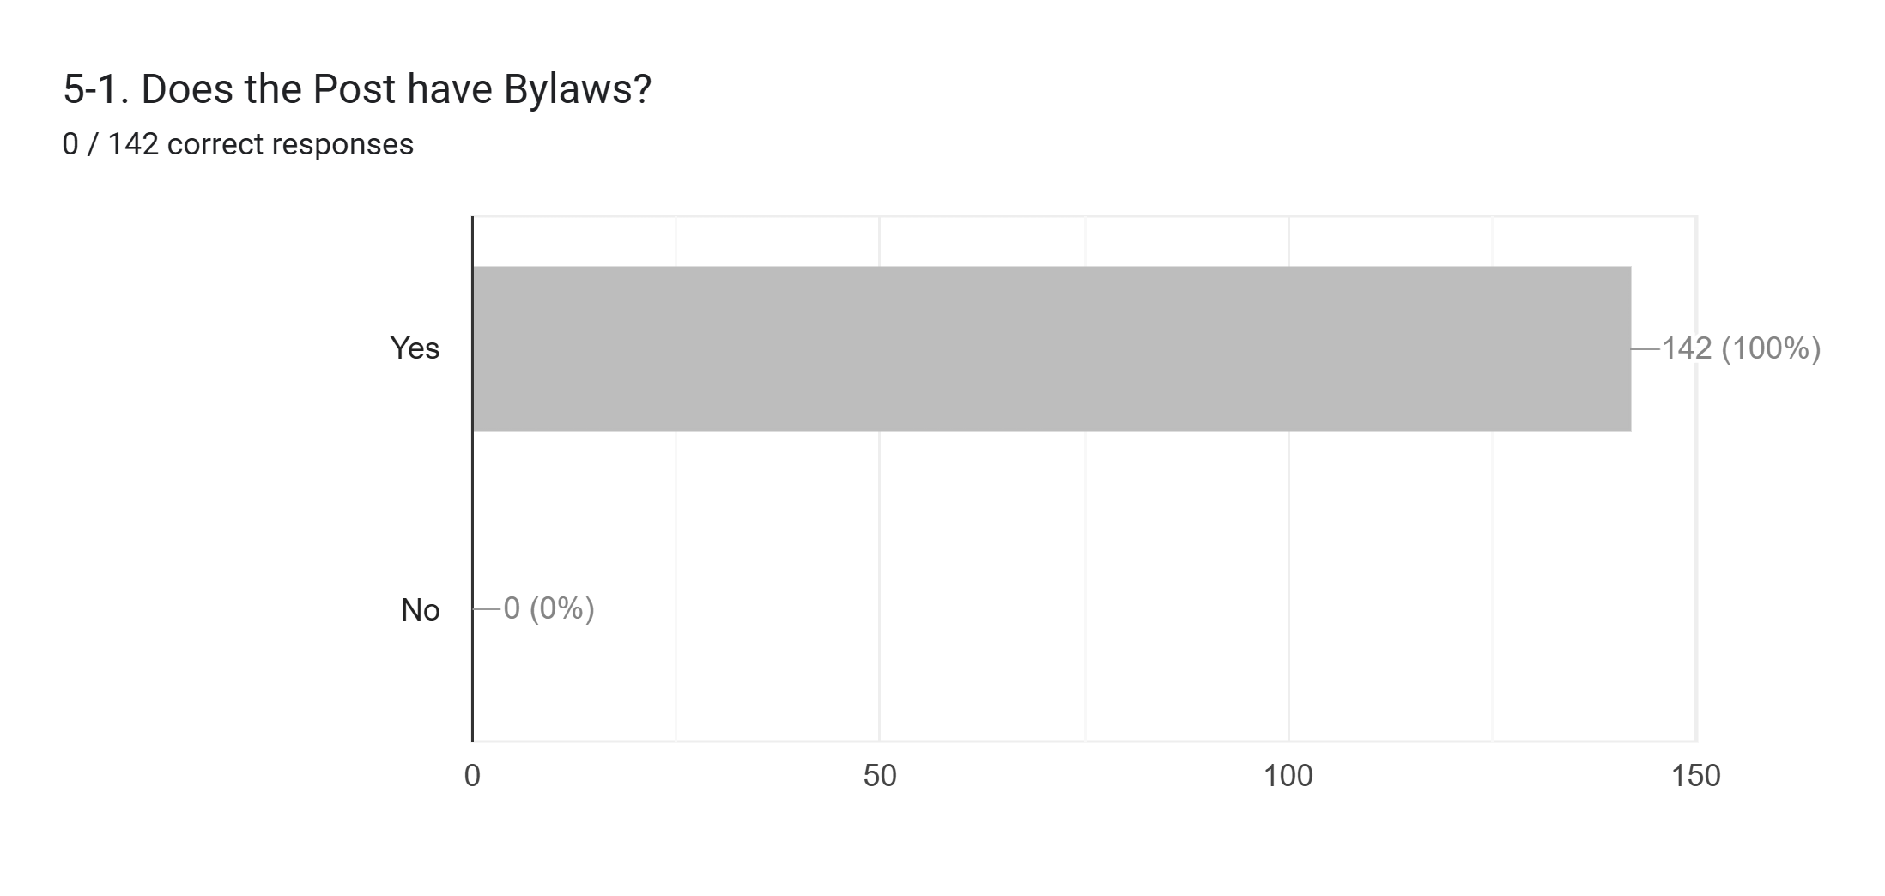
The American Legion, Department of Texas, Long Range Planning
* - Kudos to the District and Division leadership.

Slide 32
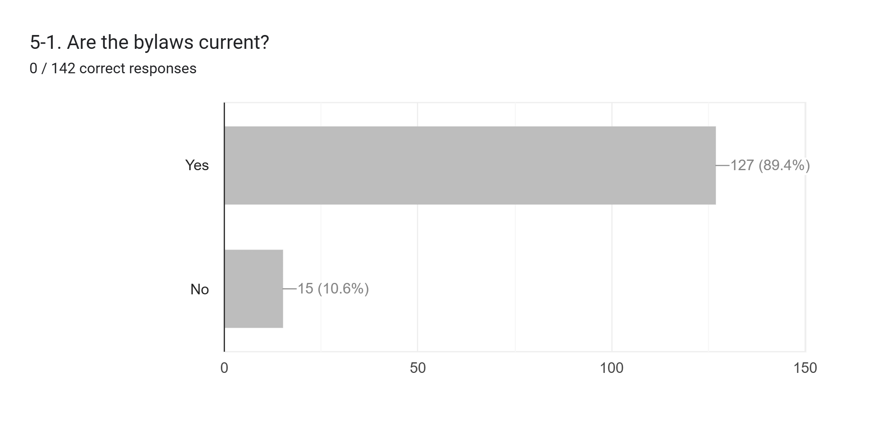
The American Legion, Department of Texas, Long Range Planning
* - District should help those who do not have current bylaws.

Slide 33
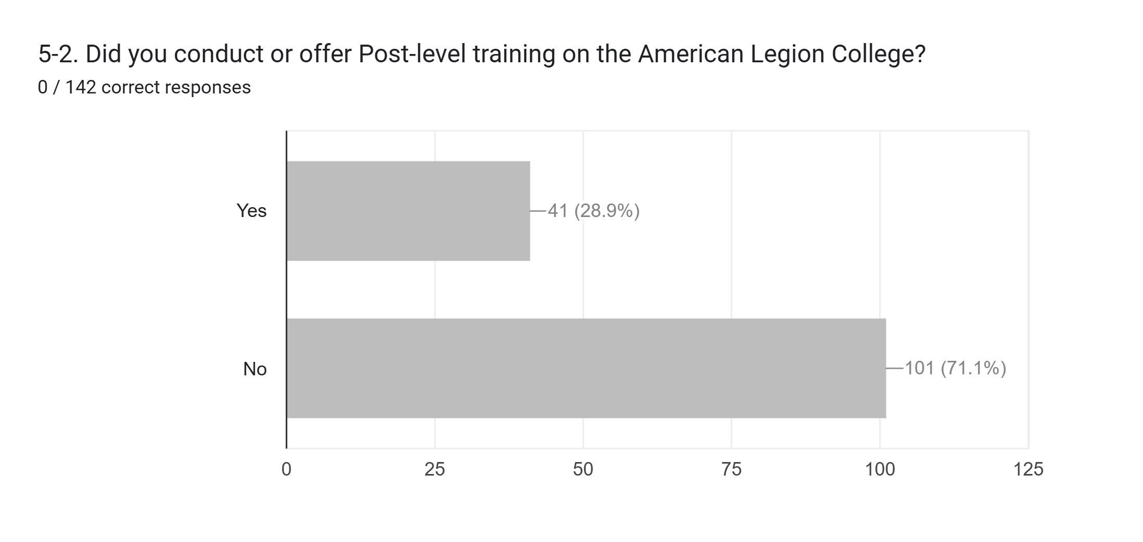
The American Legion, Department of Texas, Long Range Planning
* - Due to the average sample size of the Posts, I would expect these numbers to be low but Districts and Divisions should work with their talent to provide this training.

Slide 34
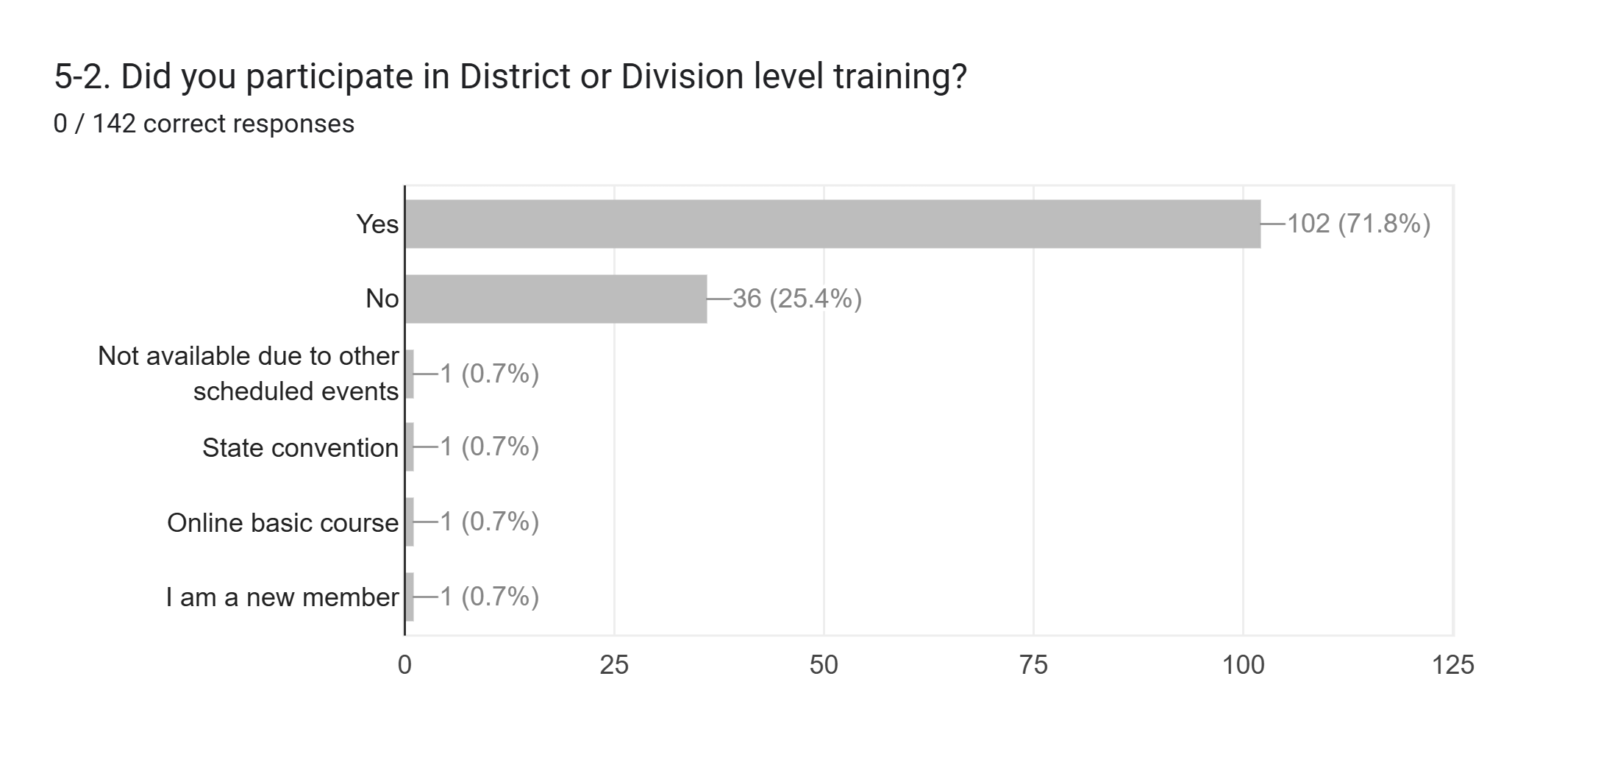
The American Legion, Department of Texas, Long Range Planning
* - Good start but this would be the expected outcome of this question if the majority of the surveys came back from leadership versus general membership. Need to get general membership educated and involved.

Slide 35
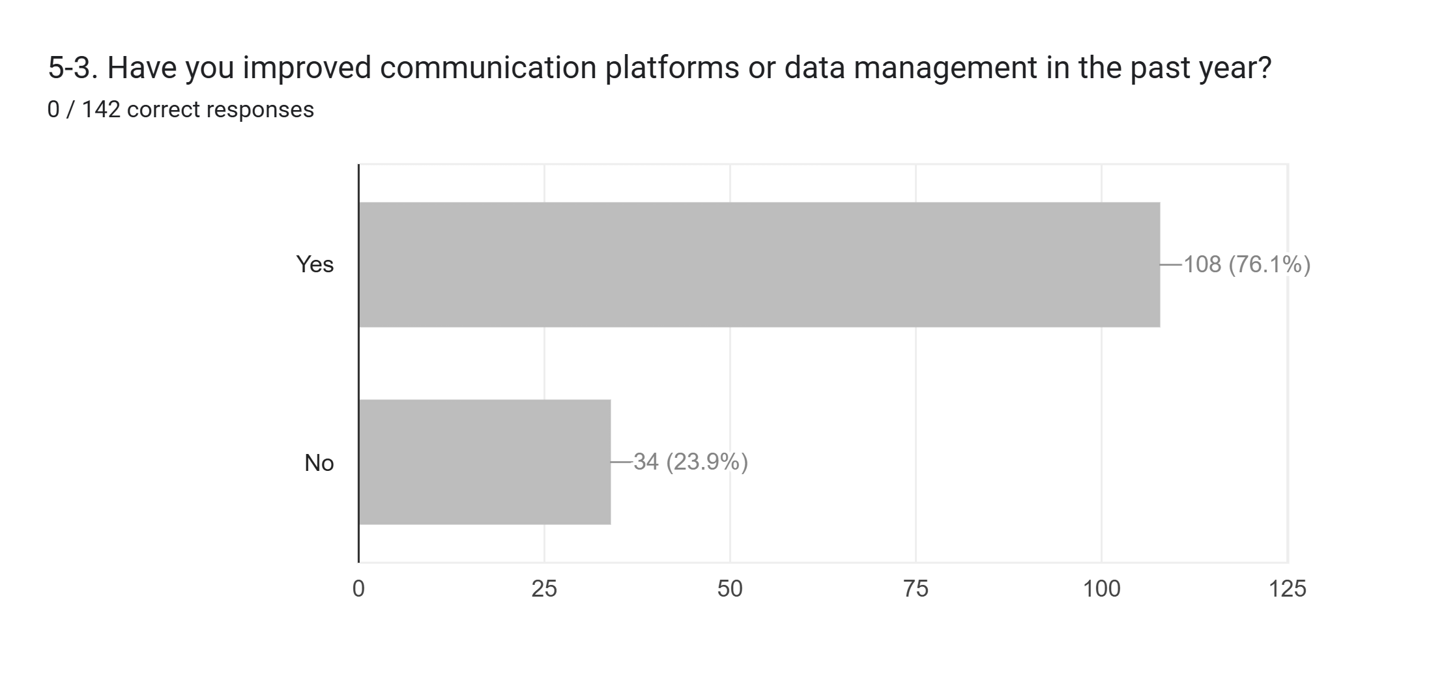
The American Legion, Department of Texas, Long Range Planning
* - Assume this will get better as the % of members who know how to use automation increases. As the older (non-computerized) generation gradually attrits, we expect these results to get better.

Slide 36
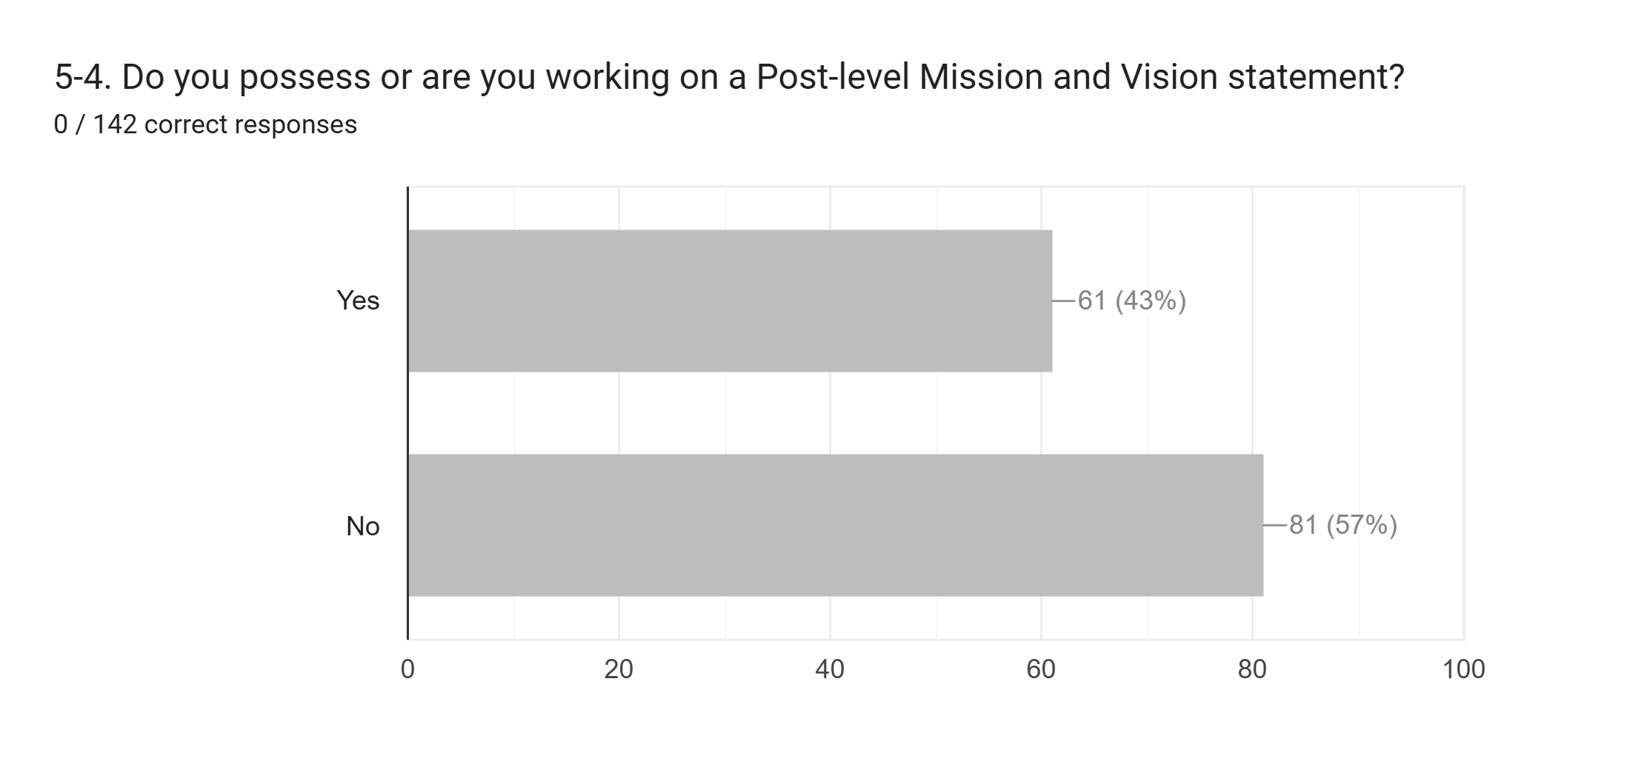
The American Legion, Department of Texas, Long Range Planning
* - This is LOE #5’s responsibility to help Posts that need guidance and direction. One Post has already inquired about help in building their strategic plan.

Slide 37
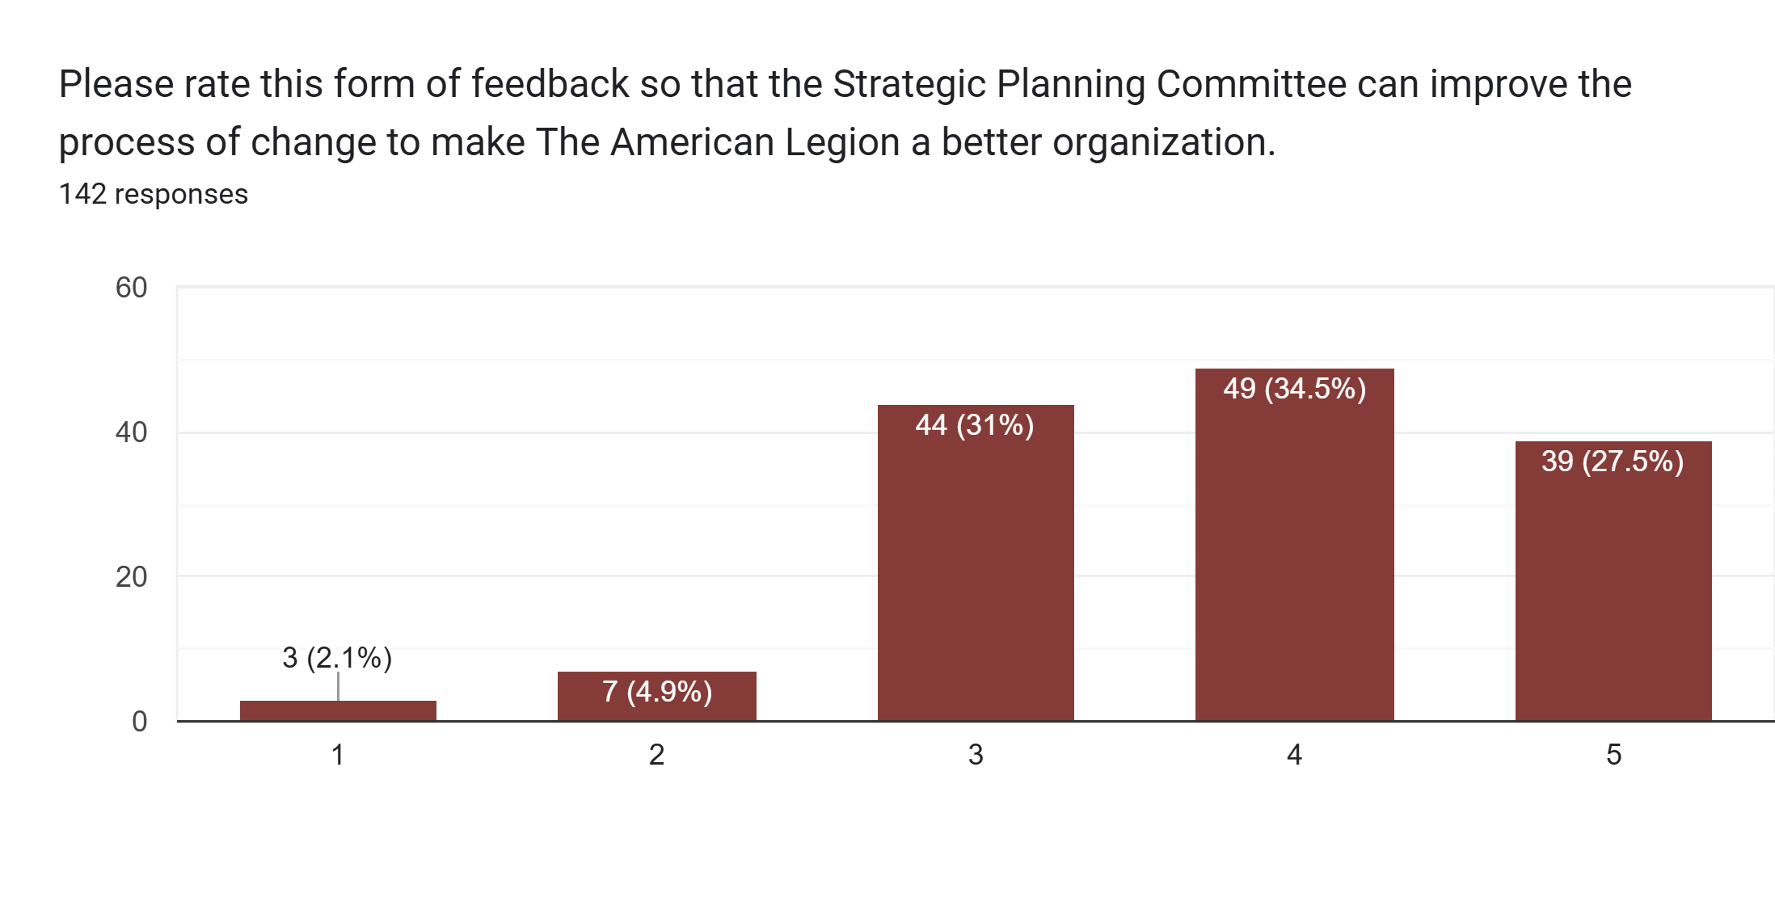
The American Legion, Department of Texas, Long Range Planning
* - Intent is to increase participation but that will come over time. Having negative responses to only 7% of the Posts who took the survey is expected.

Slide 38
The American Legion, Department of Texas, Long Range Planning
Post Survey Results
Q | Target Audience | Questions
A2 | Post | What is your Post? (4-digit number only, i.e. 0593)
A4 | Post | What is your Division? (1 digit number only)
A5 | Post | Does your Post have their own brick and mortar building?
A6 | Post | How many National patriotic events did the Post support?
A7 | Post | How many legislative committee members were appointed?
A8 | Post | How many Americanism Programs did you support last year?
1-1 | Post | Does your Post have a VSO?
1-2 | Post | Is your Post attending meetings of local elected officials or utilizing other means to share information with community and the Legion family?
1-3 | Post | Does your Post VSO programs involve improvement to access to care (healthcare needs)?
1-4 | Post | Is your Post actively involved in educating members and the community of the benefits of the PACT Act?
1-5 | Post | Does your Post have an active Lending Closet for Veterans medical equipment or something similar to help Vets/family members? Mark N/A if you do not have your own brick and mortar Post.
2-1 | Post | Do you have a current Disaster Prepardness Plan established? (more current than 2020)
2-3 | Post | Have Border Security POCs/Chairmen been appointed?
2-4 | Post | Did you partner with area AD, USAR, NGB members or families? Place N/A if none exist within 20 miles of Post.
2-5 | Post | Have you appointed any legislative committee members?
2-6 | Post | Do you have any programs supporting Emergency Responders besides the annual awards program?
2-7 | Post | Did you appoint a community relations lead (Chairman, Director, etc.)?

Slide 39
The American Legion, Department of Texas, Long Range Planning
Post Survey Results (Continued)
3-1 | Post | Do you have a newsletter?
3-2 | Post | Have you made communication improvements in the past year?
3-3 | Post | Do you have a Youth Cadet Law Enforcement Program?
3-4 | Post | How often are Buddy Checks performed at the Post level per year?
3-5 | Post | Did your Post increase, stay the same, or decrease involvement of Americanism programs last year?
4-1 | Post | Did your Post or ALR Chapter advertise accomplishments and/or the intent of supporting Children and Youth programs?
4-2 | Post | Does the Post participate in at least one info booth per year?
4-2 | Post | Did the Post provide volunteers for school visits to support Veteran Day, Armed Forces Day, or other Veteran-centric services?
4-3 | Post | Has the Post established a POC for TFA or vet support?
4-3 | Post | Have you hosted a police child safety event with drug discussions and or fingerprinting?
4-4 | Post | Did your Post establish contacts with churches and local vet support orgnaizations to help assit vets and children in need
4-4 | Post | Have you hosted or participated in Halloween safety briefs, trunk 'n' treat events, or something similar for the children?
4-5 | Post | Did your ALR chapter or Post conduct activities that earn funds for CWF?
5-1 | Post | Does the Post have Bylaws?
5-1 | Post | Are the bylaws current?
5-2 | Post | Did you conduct or offer Post-level training on the American Legion College?
5-2 | Post | Did you participate in District or Division level training?
5-3 | Post | Have you improved communication platforms or data management in the past year?
5-4 | Post | Do you possess or are you working on a Post-level Mission and Vision statement?

Slide 40
The American Legion, Department of Texas, Long Range Planning
Questions/Comments
Email: paul.goymerac@gmail.com

